Slide 1
Leadership Development: Implement A Resilient Culture Of Safety
Presented by
July 25, 2023
Notes:
Objective(s): Welcome and introduction.

Slide 2
Acknowledgement
The Just Culture curriculum was developed by Outcome Engenuity, LLC (now the Just Culture Company). This company was founded in 1997 by David Marx, JD, to help the world better manage human error by integrating concepts from systems engineering, human factors, and the law.
Learn more about The Just Culture Company at https://www.justculture.com/
The information about Just Culture has been adapted by the Nebraska Coalition for Patient Safety with permission from The Just Culture Company for the purpose of training managers in healthcare organizations.
These slides are for the internal use of Box Butte General Hospital in Alliance, NE.
Notes:
David Marx is an engineer and attorney, who has extended James Reason’s concepts of just culture be integrating systems engineering, human factors, and the law . David Marx developed the Just Culture Company, formerly called Outcome Engenuity, that offers training programs in Just Culture and root cause analysis.

Slide 3
Our Time together
9 am – Noon Begin with Just Culture
Noon – 12:30 Lunch
12:30 – 4:00 Finish with Learning Culture
Breaks at 10:30 and 2:15 for 15 minutes
This is your training. Be sure we meet your needs:
Confirm the problem statement
Ask questions to clarify confusing concepts
Agree upon our goal…
To develop a shared mental model regarding how leaders can use Just Culture, Teamwork, and Learning tools and strategies to improve organizational resilience and the culture of safety at Box Butte General Hospital.
Notes:
Objective(s): Establish the flow of the day and the goal of our time together.

Slide 4
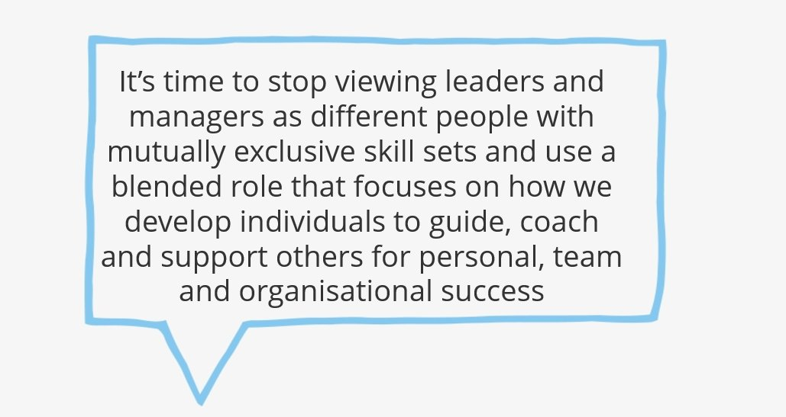
Art Petty: Dump the leader vs manager debate...
Managers can become participative leaders—leaders who intentionally include their staff in organizational decision-making. This participation results in more engaged employees and improved organizational performance. (Wang et al., 2022)
Notes:
https://artpetty.com/about-art-petty/
Participative leadership is a type of democratic leadership style in which subordinates are intentionally involved in organizational decision making. Goals of participative leadership include enhancing employees’ sense of ownership of their work, improving overall decision making, and integrating workers’ personal goals with those of the organization, write Qiang Wang, Hong Hou, and Zhibin Li in a 2022 review of participative leadership for Frontiers in Psychology.

Slide 5
PROBLEM Statement
Our leaders may not share the same mental model of the tools and strategies needed to implement a resilient culture of safety.
Notes:
CUSTOMIZED for Box Butte General Hospital
Objective(s): Centering and focusing the audience; providing the problem you wish to solve.

Slide 6
Just Culture Objectives
Define safety culture and explain the role of leaders in implementing a resilient culture of safety.
Define Just Culture as a system of shared accountability supported by 5 skills and as one of the 4 key components of a culture of safety.
Use results from your 2022 Hospital Survey on Patient Safety Culture (HSOPS) to identify opportunities for improvement in Just Culture.
Explain how outcome/severity bias complicates leaders’ response to an individual’s behavior.
Analyze how limits to human decision-making (human fallibility) result in cognitive bias (thinking fast), behavioral drift, and errors.
Analyze how leaders can design systems to decrease likelihood of human error and increase likelihood of better behavioral choices.
Identify 3 categories of behavior and the appropriate management response from the perspective of a Just Culture.
Apply the subjective and objective (i.e. substitution test) perspectives to determine what happened during an event as compared to what usually happens.
Practice using the Just Culture Algorithms to determine the just and fair response to a fatal medication error caused by human error, behavioral choices, and system design.
Notes:
Using the algorithms requires leaders to recognize employee behavioral choices in the context of the three duties, apply the subjective and objective standards, and determine how the system needs to be redesigned.
Check in to see if learners are familiar with the Vanderbilt error.

Slide 7
Objective 1
Define safety culture and explain the role of leaders in implementing a resilient* culture of safety.
*ability to manage complexity and adapt to changing conditions
Notes:
Our first objective is to...

Slide 8
What is Safety Culture?
Our shared assumptions, beliefs, and behaviors related to patient safety that are taught by leaders (Schein, 2010)
Safety culture reflects the relative importance we place on safety as compared to other organizational goals such as productivity (Zohar, 1980)
Weak safety culture is a significant contributing factor to adverse events (Mardon, et al., 2010)

Slide 9
Role of Just culture in a Culture of Safety
Learning
Reporting
(Formal & Informal)
Just
(Shared Accountability/Trust)
Flexible (Teamwork)
Safe
Informed
Just – reporting is rewarded in an atmosphere of trust; clear line between acceptable & unacceptable behavior; shared accountability between management and staff to address root causes of events
Reporting – staff report their errors
Flexible (Teamwork)– authority gradients relax when safety information is exchanged; there is psychological safety to speak up about safety related information
Learning – action is taken based on safety information systems and sensemaking conversations
Four Key Components of a Culture of Safety
Reason, J. Managing the Risks of Organizational Accidents. Hampshire, England: Ashgate Publishing Limited; 1997.
9
Notes:
9
Based upon James Reason’s work, there are four key components of a culture of safety. First, reporting practices must be supported by an atmosphere of trust and a culture that seeks to establish a shared accountability between management and individual employees. Management is accountable for the role system design may play in adverse events, and individuals are accountable for the role behavioral choices may play. Reporting and just cultures support behaviors that establish a flexible/teamwork culture--open communication, situation monitoring, seeking and offering task assistance, and advocating for patients. Reporting, just, and flexible cultures support the use of tools such as root cause analysis and process mapping that enable organizations to learn from their experience. As Reason indicates, it is the deliberate engineering of interactions between the practices of reporting, just, flexible, and learning cultures that results in a safe, informed culture.
Reporting
“Any safety information system depends crucially on the willing participation of the workforce, the people in direct contact with the hazards. To achieve this, it is necessary to implement a reporting culture—an organization in which people are prepared to report their errors and near-misses.”
Just
“What is needed is a just culture, an atmosphere of trust in which people are encouraged, even rewarded, for providing essential safety-related information—but in which they are also clear about where the line must be drawn between acceptable and unacceptable behavior.”
Flexible
“A flexible culture takes a number of forms, but in many cases it involves shifting from the conventional hierarchical mode to a flatter professional structure, where control passes to task experts on the spot, and then reverts back to the traditional bureaucratic mode once the emergency has passed.”
Learning
“An organization must possess a learning culture—the willingness and the competence to draw the right conclusions from its safety information system, and the will to implement major reforms when their need is indicated. . . In most important respects, an informed culture is a safety culture.”

Slide 10
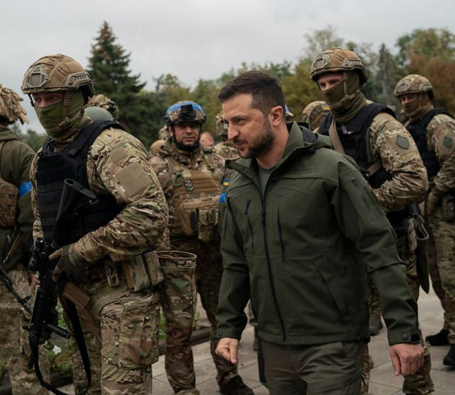
What Role do Leaders Play?
Safety culture is a result of the actions that leaders take to ensure that staff learn from their experience. Leaders implement the culture and close the gap between beliefs and behaviors by...
What they regularly pay attention to, measure, and control
How they react to adverse events and crises
How they allocate resources
How they role model, teach, and coach
How they provide feedback and rewards
Who they recruit, promote, and ignore
The language they use (Just Culture and TeamSTEPPS)
(Schein, 2010)
https://s.abcnews.com/images/Politics/WireAP_3e580095fd654b6a81d0ddd39ad160a7_16x9_992.jpg

Slide 11
Objective 2
Define Just Culture as a system of shared accountability supported by five skills and as one of the four key components of a culture of safety.
Notes:
Our 2nd objective is to...

Slide 12
Just Culture Defined
Just Culture is a set of principles that clearly differentiates acceptable and unacceptable behavior. In a just culture, “there is an atmosphere of trust in which people are encouraged, even rewarded, for providing essential safety-related information—but in which they are also clear about where the line must be drawn between acceptable and unacceptable behavior.” (Reason, 1997)
Notes:
James Reason defines just culture as.... a set of principles that clearly differentiates acceptable and unacceptable behavior. In a just culture, “there is an atmosphere of trust in which people are encouraged, even rewarded, for providing essential safety-related information—but in which they are also clear about where the line must be drawn between acceptable and unacceptable behavior.”

Slide 13
just culture defined
A system of shared accountability
Organization
Designing systems that account for human fallibility
Responding to employee behaviors in a fair and just manner
Employees
Choosing behaviors that are consistent with duties, mission, values
Reporting their errors
Reporting system vulnerabilities
A system of justice that reflects reality…fallible human beings with free will work within complex socio-technical systems.
Notes:
Objective(s): Definition of Just Culture

Slide 14
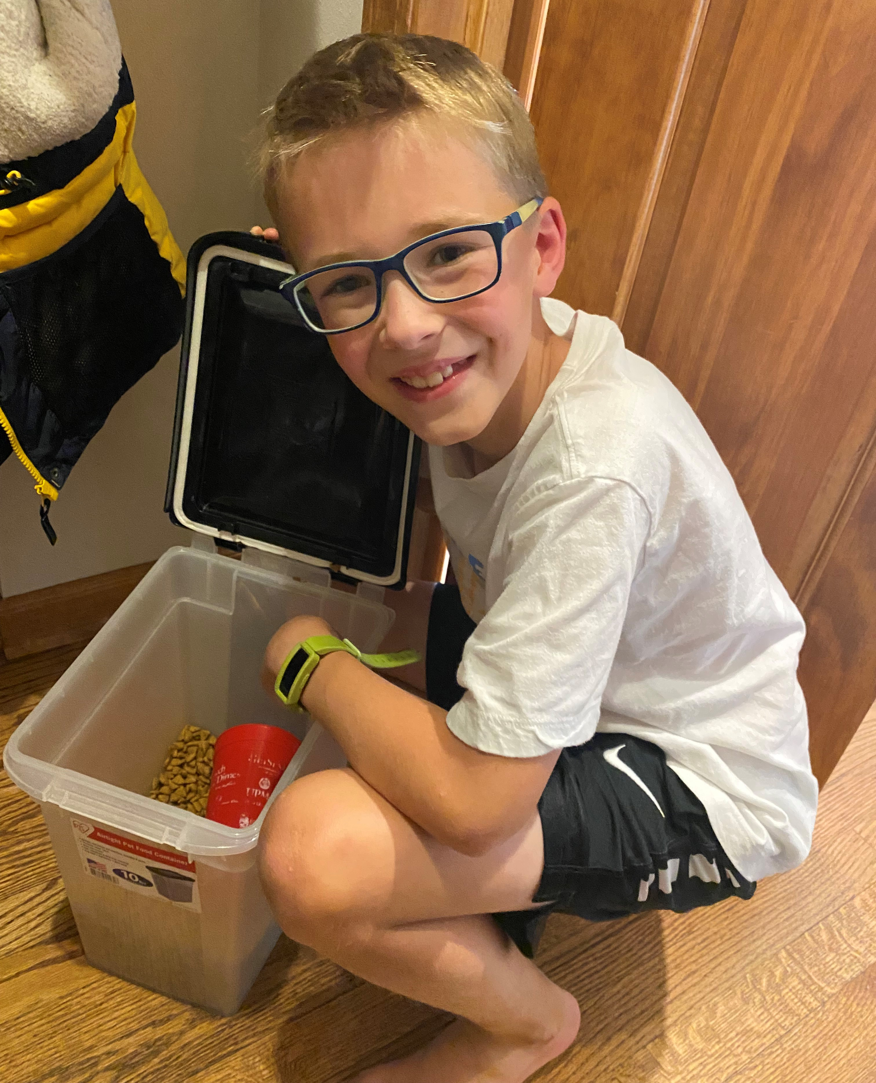
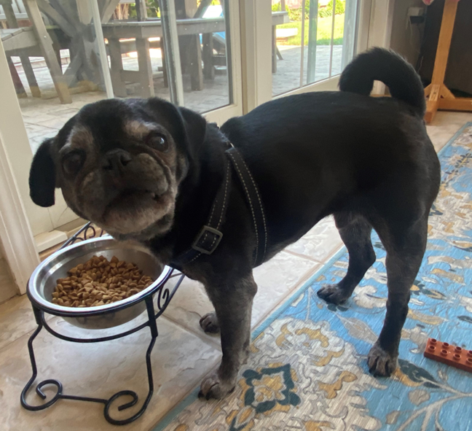
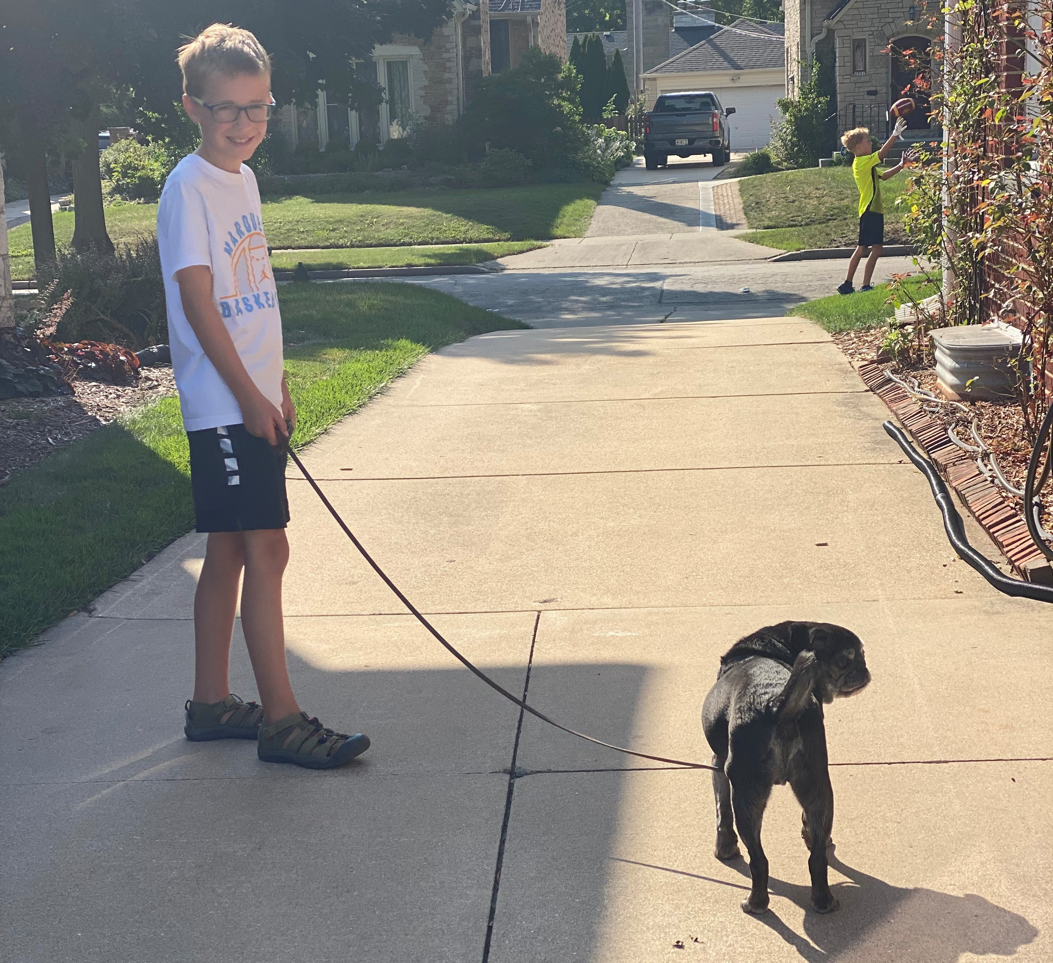
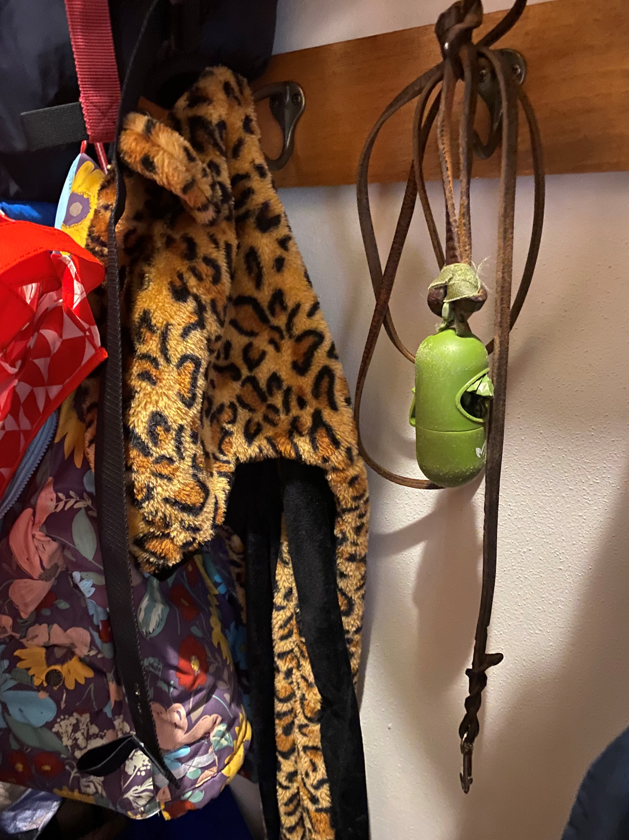
Shared Accountability
Notes:
Blade the 13 y/o black pug cared for by Drew, the 9 year old boy.

Slide 15
Objective 3
Use results from your 2022 Hospital Survey on Patient Safety Culture (HSOPS) to identify opportunities for improvement in Just Culture.

Slide 16
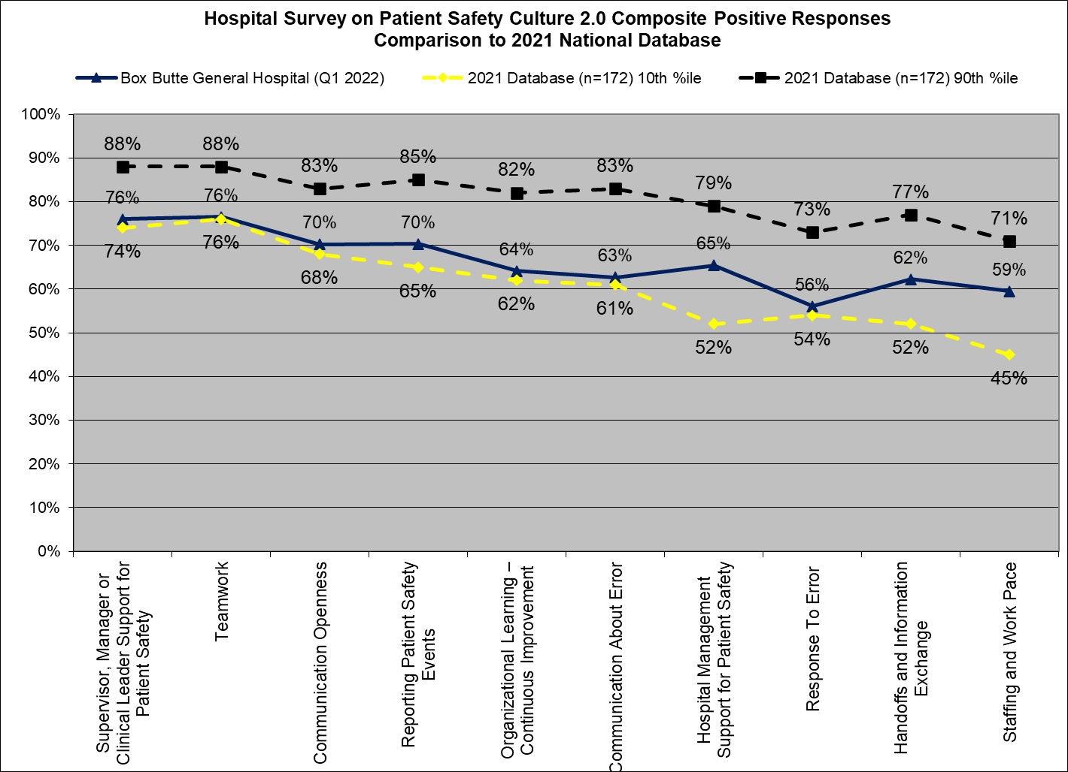
staff perceptions of Safety Culture

Slide 17
staff perceptions of Just Culture
Response Scale: Strongly Disagree to Strongly Agree
(R) = Reverse-worded item; score is the percent that Disagreed/Strongly Disagreed
BBGH Hospital Survey on Patient Safety Culture 2.0, April 2022 | Percent Positive Score
Response to Error | Dept Min | Hosp Avg | Dept Max
In this unit, staff feel like their mistakes are held against them. (R) | 32% | 56% | 80%
When an event is reported in this unit, it feels like the person is being written up, not the problem. (R) | 26% | 47% | 89%
When staff make errors, this unit focuses on learning rather than blaming individuals. | 20% | 61% | 100%
In this unit, there is a lack of support for staff involved in patient safety errors. (R) | 25% | 60% | 89%

Slide 18
Leaders Knowledge of Just Culture
3 Just Culture Champions
18/21 Managers/Leaders reported being trained to use Just Culture Algorithm
BBGH Hospital Survey on Patient Safety Culture 2.0, April 2022 | % Correct
 | Mgt | Non-mgt
What are the three categories of behavior managers identify from the perspective of a just culture? (Answer: Human error, At-risk behavior, Reckless behavior) | 62% | 11%
Which of the following is NOT a duty employees are responsible for in a just culture? (Answer: Duty to provide quality care)* | 29% | 4%
What are the three management responses to employee actions in a just culture? (Answer: Console, Coach, Punish) | 38% | 3%
During the investigation phase, what perspectives are used to determine what happened and what would normally happen? (Answer: Subjective/Objective) | 33% | 8%
*Duties are: (1) produce an outcome, (2) follow procedural rules, (3) avoid causing unjustifiable risk or harm

Slide 19
Outcomes of Implementing Just Culture Principles and Tools
Improved perceptions of safety culture
Increased event reporting and feedback and communication about error
Increased use of team skills to improve patient safety
Improved perceptions of hospital management support for patient safety
Increased staff engagement and productivity
Decreased staff burn-out and turnover
Decreased risk of patient harm!
Campione J, Famolaro T. Promising practices for improving hospital patient safety culture. The Joint Commission Journal on Quality and Patient Safety. 2018;44:23-32.
Eng DM, Schweikart SJ. Why accountability sharing in health care organizational cultures means patients are probably safer. AMA Journal of Ethics. 2020;22:E779-783.
NCPS Just Culture Collaborative 2015-2017.
Zak PJ. The Neuroscience of Trust. Organizational Culture; 2017.

Slide 20
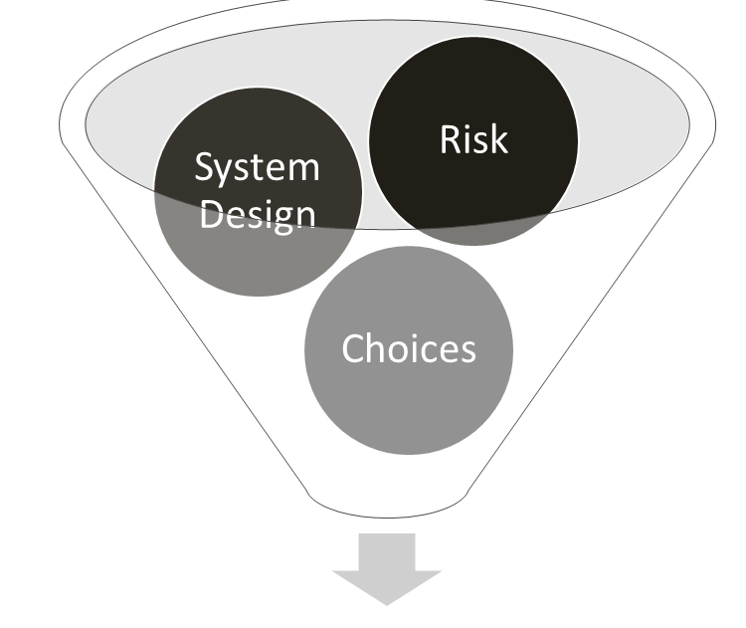
Five Skills Support Just Culture
1. ALIGN VALUES & EXPECTATIONS
2. DESIGN BETTER SYSTEMS
3. MAKE BETTER BEHAVIORAL CHOICES
4. LEARN TO SYSTEMATICALLY LEARN
Severity of Outcome
Due to Error
5. FIND JUSTICE
Notes:
Outcomes (positive or negative) are determined by the interaction between system design, risk we are willing to tolerate, and behavioral choices.
When an error happens, what is your current focus...the severity of the outcome or the system that produced the error
This is the model you will learn to change your culture from a focus on errors as outcomes, to a focus on the structures and processes such as system design, risk, and behavioral choices that produce those outcomes A key principle is to change the organization’s focus from errors as outcomes, to an analysis of how system design, risk, and behavioral choices produces those outcomes.
Risk = likelihood of an event x severity of the event.
>There are 5 specific skills needed to support a just culture and achieve better outcomes. Reflecting the principle of shared accountability... Managers are primarily accountable for skills .... 1,2,4,5 and employees are accountable for 3.

Slide 21
Skill 1: Align Values & Expectations
Safety culture is a result of the actions that leaders take to ensure that staff learn from their experience (Schein, 2010). Leaders implement the culture and close the gap between beliefs and behaviors by...
Mission Statement
To lead and innovate in healthcare delivery and community wellness.
Vision
The greatest place to receive care, to work, to practice medicine.
Values
Safety, Excellence, Compassion, Integrity, Devotion, and Teamwork
Tagline
Great Things Are Happening Here!
https://www.bbgh.org/about-us/mission-vision-values/mission-vision-values.html
Based on your HSOPS results, how well are leaders meeting the expectation to use Just Culture tools and principles?
Will improving your Just Culture knowledge and skills help to achieve your Mission, Vision, Values, and Tagline?

Slide 22
Objective 4
Explain how outcome/severity bias complicates leaders’ response to an individual’s behavior.
Notes:
Do you struggle to know how to best respond to individual employee behaviors?
In this 3rd objective we will explore why we struggle to know how to best respond to individual employee behaviors. We’ll look at two different outcomes to the event to understand outcome/severity bias and why it complicates how we respond to individual employee behaviors?

Slide 23
Outcome/Severity Bias
When leadership allows the severity of the outcome/ level of harm to drive its response to the employee behavioral choices AND system design that contributed to an event.
Notes:
What is outcome/severity bias?
When leadership allows the severity of the outcome/ level of harm to drive its response to an employee’s behavioral choice and system design.
Outcome bias affects us all – on individual, organizational, and even societal levels. In the first case, punishing someone who has committed an error that causes harm might turn out to be an overreaction. Human errors are inevitable; each of us makes mistakes. After we’ve made a mistake with an adverse outcome, we usually understand the risk involved and work to make improved choices and our approach to the task in the future. Outcome bias can involve the following:
Punishing or disciplining a person simply because there was a severe outcome
Not addressing the behavior at all when no adverse outcome results, even though harm could have occurred in similar circumstances
Addressing an entire system based on one adverse outcome
Not addressing flawed system design that could lead to an event because nothing bad has happened…yet. “no harm, no foul”
Not giving in to outcome bias will require explicit leadership from senior leaders and managers.

Slide 24
Outcome 1
An ICU nurse was asked by another ICU nurse to take 2 mg. of Versed to radiology to administer to a patient who was anxious and claustrophobic prior to a PET scan. The nurse entered “VE” into the automatic dispensing cabinet in the ICU. The Acudose machine defaults to generic drug names so Versed (midazolam) did not appear. The nurse overrode an alert that stated the drug should be for a STAT order, removed the drug, went to radiology, and administered the drug to a patient who was alone in an injection room.
Approximately 30 minutes after the administration of the drug, a transporter walked past the injection room and noticed the patient was unresponsive. It was later discovered that the nurse had administered vecuronium instead of Versed. The patient died the next day. The nurse lost her license to practice and was charged with reckless homicide. The RCA and action plan included removing vecuronium from the list of drugs for which alerts can be over-ridden by nurses and ensuring bar-code-medication-administration is available in radiology.
[See ISMP’s Guidelines for the Safe Use of Automated Dispensing Cabinets. Available at https://www.ismp.org/resources/guidelines-safe-use-automated-dispensing-cabinets ]

Slide 25
Outcome 2
An ICU nurse was asked by another ICU nurse to take 2 mg. of Versed to radiology to administer to a patient who was anxious and claustrophobic prior to a PET scan. The nurse entered “VE” into the automatic dispensing cabinet in the ICU. The Acudose machine defaults to generic drug names so Versed (midazolam) did not appear. The nurse overrode an alert that stated the drug should be for a STAT order, removed the drug, went to radiology, and administered the drug to a patient who was alone in an injection room.
Within a minute, radiology staff in the control room who were observing the patient via a camera noticed she was not breathing and called a rapid response team. The patient was intubated and recovered to her previous state. It was later discovered that the nurse had mistakenly administered vecuronium instead of Versed. The nurse was reprimanded for not following the 7 Rights of Medication Administration* at the bedside in radiology. No further action was taken.
*Right: (1) patient (2) drug (3) dose (4) route (5) time (6) reason (7) documentation
How likely is it that no further action might be taken?

Slide 26
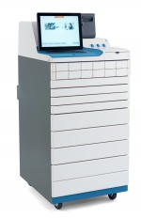
Tragic effects of Outcome /severity bias
A bad outcome caused by human error may result in punishment of an individual without redesigning the system to decrease the risk of the human error.
Lack of a bad outcome may perpetuate at-risk behaviors if managers do not redesign the system or hold individuals accountable.
Outcome / severity bias
Drugs ordered by brand but ADC menus are by generic names.
Only two letters needed to bring up drop-down menu of drugs.
Over-ride of alerts is frequent and expected.
This Photo by Unknown Author is licensed under CC BY
Notes:
Objective(s): What tragic effects result from Outcome Bias.
While many people will want to blame someone when something goes wrong, this is a dangerous game to play if we believe it is the best strategy for reducing the risk of future events. Overreacting can potentially cause harm to our culture by once again driving reporting of human error below the surface, so that individuals are hesitant to come forward to admit their mistakes and risky choices for fear of discipline or punishment. In this punitive environment, managers are unable to see the mistakes and risky behaviors that are hidden from view.
The second form of the outcome bias is failing to take appropriate action when harm does not occur. Many organizations struggle to hold people and systems accountable consistently. Often, risky behaviors may be frowned upon, yet when nothing bad happens as a result, we are lulled into complacency, thinking that the behavior wasn’t that bad, and we move on. In other instances, we may ‘turn a blind eye’ to the behavior or even reward an employee who is getting great outcomes, while circumventing our processes and requirements. In these circumstances, we are actually reinforcing at-risk or reckless choices because no harm occurred.

Slide 27
Outcome/Severity Bias
When leadership allows the severity of the outcome/ level of harm to drive its response to the employee behavioral choices AND system design that contributed to an event.
Think about times when risk may have been left in a system at BBGH because the outcome of an error was not severe.

Slide 28
Shared Accountability
Helps managers make decisions about employee behaviors that are NOT influenced by the outcome/severity of the event.
Behavioral Choices
Report errors
Support
of System
Values
Shared Accountability
Employees
Providers
Managers
Senior Leaders
System Design
Respond to Employee Behaviors
Blame-Free
Culture
Punitive Culture
The proposition is this: framed by the right systems of learning, the right systems of justice, we can design systems, and help humans make choices in those systems, to produce better outcomes at the individual, local, and societal level. David Marx, Founder of The Just Culture Company
Notes:
A Just Culture is neither blame free nor punitive culture; it is a system of shared accountability.
Employees and providers are accountable for Behavioral Choices Report errors
Managers and senior leaders and accountable for System Design and how they Respond to Employee Behaviors

Slide 29
Objective 5
Analyze how limits to human decision-making (human fallibility) result in cognitive bias, behavioral drift and errors.
Notes:
We have to accept the fact that we are all fallible.
In this objective we will explore how limits to human decision making result in cognitive bias, behavioral drift and errors.

Slide 30
The Fallible P.I.D.A. Process
Perception
Interpretation
Decision-Making
Action
Decision-Making
Sight
First, standard interpretation
(heuristics, mission focused)
System 1
System 2
Unconscious,
Automatic
Conscious,
Thoughtful
Sound
Smell
Next, is it risk?
“Risk Monitor”
(background process, harm focused)
Taste
Touch
Level of Mental Effort
Low
High
What does it mean?
Can I use a shortcut?
Is it dangerous?
How much effort do I have to expend to take action?
Information
Notes:
Objective(s): Introduction to the P.I.D.A. Model (Perception, Interpretation, Decision, Action)…how we perceive what is going on around us, interpret the signals and make a decision as to how to respond.
Guidance to Instructor(s): Guidance on how to put yourself in someone else’s shoes and determine intentions. This will be revisited in the Reasonable Person Standard and when using the Algorithm. Teach the process first…1. passive through 5 senses, 2. standard interpretation is practical problem solving; then “is this risky?” 3. Decision regarding level of mental effort: do I need conscious effort; if not, I can be on auto pilot; 4. Take action
Tip(s) for Instructor(s): Because there are four steps in the PIDA process, we can improve system design at each step of the process: 1. increase information, 2. ensure we consider level of risk, 3. identify when we need to think slow (eg high alert meds, surgical timeout, 7 rights of medication administration, two identifiers, consciously link fall interventions to specific risk factors and not a score, what else? Humans have two ways of thinking and attending to information in the world around them (we allocate our attention to two systems)
System 1—Thinking fast…automatic, fast, no effort, no sense of voluntary control…leads to cognitive biases:
Inattentional blindness—Intense focus on a task can make people effectively ignore other stimuli
Anchoring—reliance on an initial piece of information, which may be irrelevant, to make subsequent judgments
Availability—make judgments about probability of an event based on ease (availability) of recalling examples
Choices (prospect theory)—we are loss-averse; we are more likely to act to avoid a loss than to achieve a gain
Framing—context in which choices are presented
Substitution bias—substitute the answer to a simple question when you are really trying to answer a more complex question
WYSIATI (What you see is all there is)
System 2—Thinking slow…conscious decision to allocate attention to a specific mental activity

Slide 31
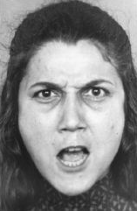
Thinking fast and slow
How we think (cognitive bias) leads to error
Humans have two ways of thinking and attending to stimuli in the world around them (we allocate our attention to two systems)
System 1—Thinking fast…automatic, no effort, no sense of voluntary control
System 2—Thinking slow…conscious decision to allocate attention to a specific mental activity
All clinical decision-makers make errors due to cognitive bias
¾ of diagnostic errors may be due to these mental shortcuts
17
x 24
Kahneman D. Thinking Fast and Slow. New York: Farrar, Straus, and Giroux; 2011.
O’Sullivan ED, Schofield SJ. Cognitive bias in clinical medicine. J R Coll Physicians Edinb. 2018; 48: 225–232.
Notes:
Control of our attention is shared by two systems

Slide 32
An Example of Human Fallibility
The Monkey Business Illusion - YouTube
(Chabris & Simon, 2010; Kahneman, 2011)
Notes:
You can multitask but only if the tasks are easy and undemanding; intense focus on a task can make people effectively ignore other stimuli (e.g. The invisible gorilla)
Google Daniel Simon Monkey Business Illusion...show this video example of inattentional blindness and then refer learners to the references to learn about other types of cognitive bias.
The Monkey Business Illusion - YouTube
Chabris C & Simons D. The Invisible Gorilla: How Our Intuitions Deceive Us. New York: Random House; 2010.
Kahneman D. Thinking Fast and Slow. New York: Farrar, Straus and Giroux, 2011.
https://en.wikipedia.org/wiki/Thinking,_Fast_and_Slow

Slide 33
Thinking fast
Example: Vanderbilt Fatal Medication Error
Inattentional blindness—You limit the information you perceive by intensely focusing on one task. People can multitask but only if the tasks are easy and undemanding.
Anchoring—You rely on an initial piece of information, which may be irrelevant, to make subsequent judgments
Framing effect—You can draw different conclusions from the same information, depending upon how it is presented.
Availability—make judgments about probability of an event based on ease (availability) of recalling examples.
RaDonda was also orienting a new-graduate RN to the Neuro-ICU during this shift.
“VE” = Versed
00
Hospital administration sent emails supporting use of override to ensure patients received timely
Care.
Mrs. Murphey had already received 20+ drugs that included an override.
Notes:
Choices (prospect theory)—we are loss-averse; we are more likely to act to avoid a loss than to achieve a gain
Framing—context in which choices are presented
Substitution bias—substitute the answer to a simple question when you are really trying to answer a more complex question
WYSIATI (What you see is all there is)
Chabris C & Simons D. The Invisible Gorilla: How Our Intuitions Deceive Us. New York: Random House; 2010.
Kahneman D. Thinking Fast and Slow. New York: Farrar, Straus and Giroux, 2011.
https://en.wikipedia.org/wiki/Thinking,_Fast_and_Slow

Slide 34
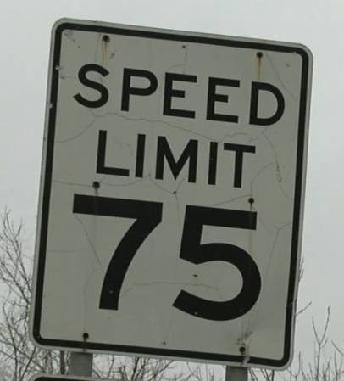
To err and to Drift are human
Human behavior tends to drift to the unsafe space
Understand when and why people are drifting and hold them accountable for following procedural rules

Slide 35
To Err and Drift at BBGH
Think about a time when you made a human error...were you thinking fast?
Share your experience with the person next to you.
Then discuss the behaviors at BBGH that tend to drift to the unsafe space.
Share with the group.
Notes:
Objective(s): To Drift is Human.
Guidance to Instructor(s): To Drift is Human (p. 14).

Slide 36
Objective 6
Analyze how leaders can design systems that decrease the likelihood of human error and increase the likelihood that individuals will make better behavioral choices.

Slide 37
Skill 2: Design better systems
1. ALIGN VALUES & EXPECTATIONS
2. DESIGN BETTER SYSTEMS (that account for human fallibility)
3. MAKE BETTER BEHAVIORAL CHOICES
4. LEARN TO SYSTEMATICALLY LEARN
Severity of Outcome
Due to Error
5. FIND JUSTICE
Notes:
Outcomes (positive or negative) are determined by the interaction between system design, risk we are willing to tolerate, and behavioral choices.
When an error happens, what is your current focus...the severity of the outcome or the system that produced the error
This is the model you will learn to change your culture from a focus on errors as outcomes, to a focus on the structures and processes such as system design, risk, and behavioral choices that produce those outcomes A key principle is to change the organization’s focus from errors as outcomes, to an analysis of how system design, risk, and behavioral choices produces those outcomes.
Risk = likelihood of an event x severity of the event.
>There are 5 specific skills needed to support a just culture and achieve better outcomes. Reflecting the principle of shared accountability... Managers are primarily accountable for skills .... 1,2,4,5 and employees are accountable for 3.

Slide 38
What is a System?
A set of elements that interact to produce an outcome
Donabedian’s Framework is the foundation of quality assessment in health care
How care is delivered, organized, financed People, equipment, policies/procedures Equivalent to system design, capacity for work | Tasks performed that are intended to produce an outcome Most closely related to outcomes Causal relationship between process & outcomes | “Ultimate Validator” Changes in individuals and populations due to health care Time to develop, multifactorial, random component
Donabedian A. An introduction to quality assurance in health care. New York: Oxford University Press; 2003.
38
Notes:
A system is a set of elements that interact to produce an outcome. There are different ways to think about these elements; one way is to think in terms of structure, process, and outcome. In systems thinking, we want to understand the “big picture” --how all of the elements interact dynamically to produce an outcome.
Within Donabedian’s framework, outcomes are defined as changes in individuals and populations due to healthcare, and structure refers to how care is organized, financed, and delivered. Structure determines a system’s capacity for work and may be the primary determinant of the quality of care a system can deliver. Process refers to actions taken; how people use structures to produce outcomes. Donabedian’s structure-process-outcome framework is a system of interacting elements that is causal in nature—improving outcomes requires innovation in structure and/or process. The relationships between S-P-O are probabilistic; that is EB structures are more likely to produce EB processes, that lead to desired outcomes.
Think of the S-P-O framework as an explanatory framework…in complex social interventions, it explains why we think an innovation might change outcomes.
So many of our quality initiatives look to process and technology and we pay too little attention to the human side…how people are trained and organized.
A word about outcomes….we often measure processes as proxies for outcomes because they can take time to develop. Thus, Donabedian asserted that a complete assessment of quality requires measurement of S-P-and O.
As a health services researcher, I have found that we often pay too little attention to structure. According to Donabedian’s framework, what might training in Just Culture do for your organization?

Slide 39
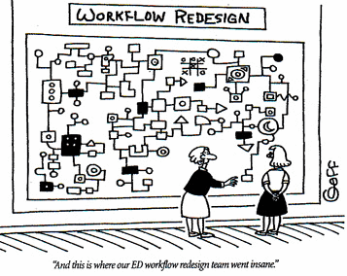
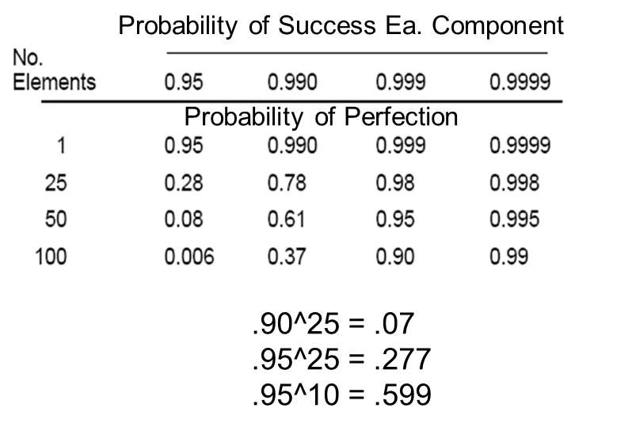
Complexity of Systems
http://joevaughan.com/emergent-enterprise/noone-ever-fixed-a-process-by-adding-more-process/attachment/complex-process/
Health care is a sociotechnical system; human beings work in social structures within complex technical environments to achieve goals.
Teams are better able to manage complexity than are individuals.
Braithwaite et al. Towards safer, better healthcare: harnessing the natural properties of complex sociotechnical systems. Qual Saf Health Care 2009;18:37–41.
Salas E, Sims DE, Burke CS. Is there a “Big Five” in teamwork? Small Group Research. 2005; 36:555-599.

Slide 40
Human performance strategies
INVALID…
VALID…
Make no errors
Be 100% attentive
No harm, no foul
Machines are 100% reliable
Knowledge and skill
Shape performance using system design
Improve risk perception using debriefs
Teams manage complexity better than individuals

Slide 41
System Design Hierarchy
implement environment
Simplify processes
Standardize equipment
Support from leadership
Strong Actions
Intermediate Actions
Weak Actions (rely on human vigilance)
Combinations are most effective
Build in redundancy (independent double-checks)
Implement checklists
Standardize communication
Simulation-based training
Alerts and Warnings
New policy/procedure/memo
Training and education
National Patient Safety Foundation. RCA² Improving Root Causes Analyses and actions to Prevent Harm. Available at: https://www.ihi.org/resources/Pages/Tools/RCA2-Improving-Root-Cause-Analyses-and-Actions-to-Prevent-Harm.aspx

Slide 42
System design Reflects the PIDA Process
Strong and Intermediate | Example
Structure the ENVIRONMENT to limit the precursors to human error and at-risk behavior. | Housekeeping responsible for ensuring a clean gait belt is on hook at the head of the bed in each room.
Create BARRIERS to errors by using equipment/technology to limit the interpretations/ decisions we need to make. | Smart infusion pumps contain pre-programmed libraries with standardized dosing for commonly used intravenous medications
Add parallel elements for REDUNDANCY to double-check accuracy of “thinking slow.” | Independent double check of high alert medications and calculations for weight-based dosing.
Use checklists and technology to RECOVER from errors before the patient is harmed. | Bar Code Medication Administration at bedside 7 rights of medication administration (patient, drug, dose, route, time, reason, documentation) Surgical Safety Check List Sponges with radiopaque marker

Slide 43
System Design
Think about the system changes made by Vanderbilt University Medical Center after the CMS Survey
Revised policies: Transport of Critically Ill Patient, High Alert Medication Policy, Medication Administration Policy to include monitoring of patients after administering High Alert medications
Removed vecuronium from override in the ADC
Implemented barcode medication administration in radiology
Implemented 2nd nurse verification of the accuracy of orders in radiology
Implemented changes to ordering paralytic drugs from the ADC... a nurse must first type in PARA to obtain a paralytic drug
Discuss the effectiveness of the changes with the person next to you. Is there anything else you might recommend?

Slide 44
System design:
SCENARIO
Wrong RX in NICU
BACKGROUND INFORMATION: In Indianapolis, prosecutors questioned, several Methodist Hospital neonatal ICU nurses and a pharmacy technician after three premature infants died of heparin overdoses.
The pharmacy technician had accidentally stocked the unit with vials containing adult doses of the drug rather than infant doses.
Six infants received an incorrect dose; three recovered.
"Ultimately, the blame for our errors falls upon the institution," said Sam Odle, president and CEO of Methodist Hospital, following the first two deaths. “This is a system failure.”
Source: American Journal of Nursing, 2007
How do we typically prevent human errors like this from reaching the patient?
Change the environment (adult and pediatric vials looked similar)
Use redundancy (independent double check of high alert meds)
Provide for recovery (BCMA and 7 Rights)
Notes:
Objective(s): Setting up for a hypothetical that will analyze a risky behavior that had system design precursors.
Guidance to Instructor(s): This happened in at least two hospitals.

Slide 45
System design:
SCENARIO Fall while Toileting
BACKGROUND INFORMATION: In a hospital, the fall-risk-reduction policy states that patients at high risk for falls are not to be left alone while toileting. A patient who was at high risk and on an anticoagulant requested privacy in the bathroom. The CNA stepped out, the patient attempted to stand from the toilet, fell and hit her head, and ultimately died due to a subdural hematoma.
The CNA had not received training in how to respond to patients at high risk for falling who requested privacy in the bathroom. She was thinking of the need to maintain high patient satisfaction.
Source: CAPTURE Falls Project, UNMC
How do we typically prevent decision-making (judgment) errors like this from reaching the patient?
We impose a duty (policy/procedure) for which the employee is accountable. In this case, patients who were at high risk for falling were not to be left alone in the bathroom. However, management did not anticipate that staff may interpret requests for privacy as more important than safety. Train staff: “I respect your desire for privacy, but your safety is our highest priority. And we know that patients are most likely to be seriously injured if the fall in the bathroom.”
Notes:
Objective(s): Setting up for a hypothetical that will analyze a risky behavior that had system design precursors.
Guidance to Instructor(s): This is one news report for one hospital, but this happened in at least two hospitals.
Tip(s) for Instructor(s):
Instructor(s) Notes:

Slide 46
Questions? Concerns? ideas?
As a manager, you control system design to limit the stimuli in the environment, create barriers to errors, provide for redundancy in risky processes, and facilitate recovery from errors.
You also hold employees accountable for making better behavioral choices by imposing duties.
Notes:
Objective(s): Summarize System Design. As a manager you have control over system reliability … we should design systems that anticipate human error, detect errors before they become critical and address the consequences of our errors. The best systems predict where humans will make mistakes and where system design will fail.

Slide 47
Objective 7
Identify 3 categories of behavior and the appropriate management response from perspective of a Just Culture.

Slide 48
Skill 3: Make Better Choices
1. ALIGN VALUES & EXPECTATIONS
2. DESIGN BETTER SYSTEMS that account for human fallibility
Future Focus
Future Focus
3. MAKE BETTER BEHAVIORAL CHOICES
4. LEARN TO SYSTEMATICALLY LEARN
Severity of Outcome
Due to Error
5. FIND JUSTICE
Notes:
Just culture shifts the focus from errors and outcomes to system design and behavioral choices. As Leaders, we need to know how to respond to errors and the range of behaviors appropriately, fairly, and consistently.

Slide 49
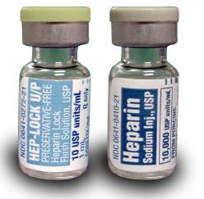
Human fallibility and intentions
Human error (mistakes, slips, lapses) lacks intent!
We do things we do not INTEND to do because we think fast (cognitive bias).
We have free will.
We make 100s of choices every day.
We drift from safe choices.
We make choices that are self-serving.
Look-Alike vials similar to those that led to deaths of premature infants
https://www.ismp.org/resources/infant-heparin-flush-overdose
The Just Culture Company, 2021
Notes:
Unfortunately, we are inescapably fallible creatures. We are going to do things we never intended to do. We’ll use words like mistake, slip, and lapse to describe a category of behavior we call human error. Misspelling or mispronouncing a word I know is a good example of human error. Human errors are the actions we never intend. If you were to count the errors we each make throughout the day, the total would likely be in the hundreds.
Beyond our propensity to error, humans are blessed with free will. This means we will make choices that are sometimes less than optimal. We will also make choices that are entirely self-serving, potentially putting others at risk of harm. How many of you sometimes go through a yellow light? Or roll through a stop sign in a familiar intersection? Or drive a few miles an hour over the speed limit?

Slide 50
Human intentions
Outcome – Is it your intent to cause harm?
Purpose: conscious objective to cause harm?
Knowledge: do you know that harm is practically certain to occur if you behave as you intend?
Conduct – What did you do?
Reckless
At-Risk Behavior
Human Error
“The Three CORE Behaviors”
Notes:
As we move into the bottom section here, we will discuss the intention of the act itself – “risk-taking”, rather than the intention to cause an outcome – “harm”
(The definitions are not provided, as we will take a closer look at these in the following slides.)
These are the three core behaviors we will focus on as we learn to respond to human behavior in the workplace, appropriately and consistently. We will rarely, if ever, see the top two behaviors in our workplace.
Reckless, at-risk, and human error are also sometimes referred to as the three “manageable” behaviors.
Don’t go into detail here for reckless, at-risk, and human error. The following slides will take a closer look at these.

Slide 51
The three CORE behaviors
KEY = intent toward act or conduct
Human Error
NOT A CHOICE!
Slip – doing something other than intended
Lapse – an omission – forgot to do something
Mistake – misperception, mistake of fact – looked at A, but saw B
Inadvertent action: slip, lapse, mistake
Conscious disregard of a substantial and unjustifiable risk
Manage through changes in:
Processes
Procedures
Training
Design
Environment
Behavioral Choices
Have you ever made an error? Can you share an example? How did you feel?
How can you support the people in your organization – set them up for success?
CONSOLE HUMAN
MANAGE SYSTEM
Notes:
To err is human. We have all heard the phrase, but what does it really mean? We define human error as inadvertently doing other than what should have been done: a slip, lapse, or mistake.
Again - Human Error is not a choice!
Slip – doing something other than intended, lapse – an omission (forgot to do something) – mistake of fact (perceived something incorrectly – looked at A and saw B)
How do people generally feel when they have made a mistake? (embarrassed, ashamed, at fault)
Ask someone to share an example of when they made an error. (or give example of Tylenol pm given to kids going to school).
Respond: When we determine that a human error has occurred – the response to the individual is to console the person. The consoling conversation is one that acknowledges the event, the emotions of the employee and seeks to provide an appropriate comforting response. They are human. This was not what was intended.
Manage: Don’t stop there! As a leader, you will also want to understand what system factors may have contributed to the error.
Example of a human error – running a red light. Why? Didn’t see it. Why? Distracted. Unfamiliar route. Rain/snow. Looked away for a moment?
Healthcare example – can you give me an example from your organization? – wrong medication. Why? Look-alike sound alike. Workflow interruption, distraction. Lighting. No process for independent double check.
Console (p. 30): In the Just Culture model, in response to a person who has made a human error, we suggest that a manager simply ‘console’ the person. Human beings can experience a sense of loss when confronted with their own fallibility. There may be other emotions such as embarrassment, shame and disappointment felt by the employee who has made a human error. What then is the act of ‘consoling’? It is when we seek to alleviate the grief, sense of loss or anxiety caused by the event by comforting the employee – our fellow, inescapably fallible human being. The consoling conversation is one that acknowledges the event, the emotions of the employee and seeks to provide an appropriate comforting response. The employee and manager might also choose to discuss the human error to better understand how it occurred and may be managed in the future. Be prepared to become skilled at consoling, and how to look at the system to consider improvements to limit further errors. The genuine fixes will be in system design.

Slide 52
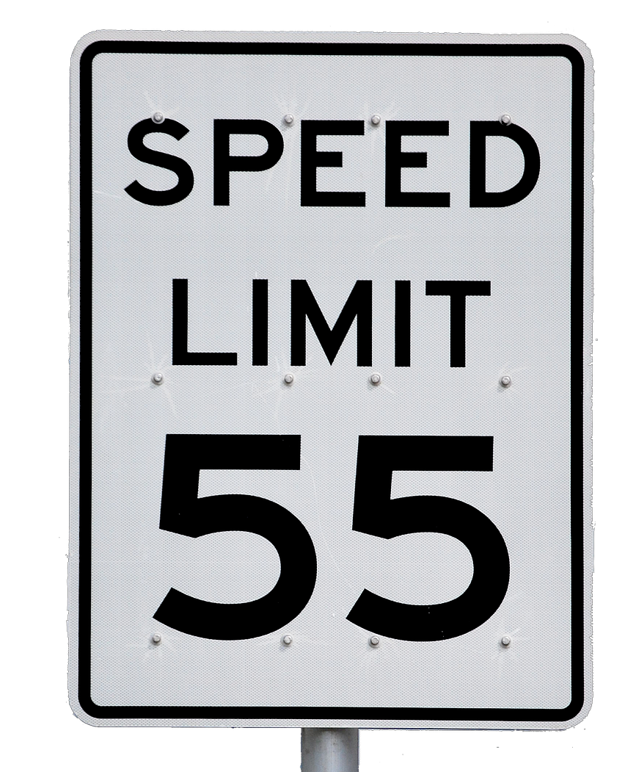
The three CORE behaviors
KEY = intent toward act or conduct
“Drift”
Why do we drift?
What are some examples of drift?
At-Risk Behavior
What is an “incentive” for at-risk behavior?
A choice: risk not recognized or believed justified
Manage through:
Removing incentives for at-risk behaviors
Creating incentives for healthy behaviors
Increasing situational awareness
Help employee “see” and understand the risk
Make the right thing to do the easy thing to do
COACH HUMAN
MANAGE SYSTEM
Notes:
At Risk behavior is a behavioral choice – it is conduct that is intended. We choose it, but with the belief we are not taking an unjustifiable risk to those around us.
At Risk behavior increases risk where risk is not recognized or is mistakenly believed to be justified. (p 35-38)
Remember the PIDA model here – sometimes this is where people get into trouble “thinking fast” – actions become routine, we become complacent as we get comfortable, we drift into unsafe behavior because of how we see and perceive things – we are driven to take shortcuts to achieve our objectives. There are many human factors that come into play and need to be evaluated to promote safe behavior.
Examples: Think about when you first started to drive a car. Your hands were at 10 and 2 on the wheel, you drove under the speed limit and you slowed down as soon as you approached any intersection. You followed the rules very carefully.
If you think about your habits today, how much have you deviated from what you were taught? Maybe you drive with one hand – you have a coffee or soda in the other hand – maybe you go a few miles over the speed limit? Do you go through yellow lights or roll through a stop sign at a familiar intersection? Most of the time, nothing bad happens – no crashes, no tickets.
As humans we drift from safe behavior as we get comfortable with a task, system or environment.
We are mission focused - the outcomes we seek drive our conduct – more than rules. When faced with choices we weigh the consequences and/or incentives associated with each choice. There are no absolutes when we evaluate at-risk behavior – it depends on the individual’s perceptions.
Coaching is the appropriate response to at-risk behavior. Talking to the employee about the risks of a certain choice and the need to engage in safe choices. It involves raising awareness and/or changing the perceptions of risk – understanding the consequences, and aligning expectations about how the risk should be managed.
Do not wait for a bad outcome to have the coaching conversation!
Also, as a leader, do you understand what incentives were there? What were the performance shaping factors that led to the risky behavior? (workaround) Can you remove them? Create incentives for healthy behavior. Make the right choice the easy choice! (is the process outdated?)

Slide 53
The three CORE behaviors
KEY = intent toward act or conduct
This is where we “draw the line.”
Intentionally taking a “gamble” on the outcome.
This is the one behavior we expect our employees to absolutely avoid.
Reckless Behavior
Conscious disregard of a substantial and unjustifiable risk
Manage through:
Remedial action
Disciplinary action
Punitive action
What is a real-world example
of reckless behavior?
Consult with HR on appropriate disciplinary action
Consider review of hiring and oversight processes
PUNISH HUMAN
MANAGE SYSTEM?
Notes:
A person engaging in reckless behavior recognizes the risks associated with the chosen behavior.
Specifically, reckless behavior involves a conscious disregard of a substantial and unjustifiable risk of causing harm.
It is the one behavior we should expect our employees to absolutely avoid. This is where we “draw the line”.
It is not an intention to cause harm, but merely the willingness to accept an unjustifiable risk.
It is most easily viewed as “gambling” toward the possible outcome.
It is to put personal interest ahead of an unjustifiable risk of harm to others.
The reckless person does not intend the outcome; they just choose the gamble.
Ask participants to give an example of reckless behavior.
Example – running a red light. Texting while driving.
What other examples can you think of in healthcare that might be reckless?
Surgeon drops an instrument on the floor. Upset by the delay, she reaches down, picks it up and continues to use it.
Nurse gets to patient room with two syringes in pocket, neither are labeled. She knows one was for her patient and doesn’t remember where the other came from. Knowing that the pt was supposed to receive 2ml injection and the other syringe is 1.5 ml, she gives the 2 ml unlabeled medication to the patient.
The reasons for engaging in reckless conduct are as varied as the conduct itself, but none of the reasons can excuse recklessness toward the safety of fellow employees customers, clients or patients, or the general public.
In a Just Culture, reckless behavior is where we consider disciplinary or punitive action as means to correct the undesired conduct.
Generally, reckless behavior may not have a system issue to manage. But – you may want to look at this – how did this person get hired? What systems are in place to detect and report this behavior quickly? Do staff feel safe to report? Are there “norms” at play in your organization that support reckless behavior?
Objective(s): Reckless Behavior. How to define, how to manage, and how to respond.
Tip(s) for Instructor(s): first share a non-healthcare, relatable at-risk behavior (example: 25mph over the speed limit), then bring the concept into healthcare.
Instructor(s) Notes: The Management of Reckless Behavior (p. 43):

Slide 54
The Biggest Threat to Safety?
Human Error
At-Risk Behavior
Reckless Behavior
Inadvertent action: slip, lapse, mistake
A choice: risk not recognized or believed justified
Conscious disregard of a substantial and unjustifiable risk
Manage through changes in:
Processes
Procedures
Training
Design
Environment
Behavioral Choices
Manage through:
Removing incentives for at-risk behaviors
Creating incentives for healthy behaviors
Increasing situational awareness
Manage through:
Remedial action
Disciplinary action
Punitive action
CONSOLE HUMAN
MANAGE SYSTEM
COACH HUMAN
MANAGE SYSTEM
PUNISH HUMAN
MANAGE SYSTEM?
Notes:
Which of these three behaviors is the biggest threat to safety?
<Animation – click again> At-Risk Behavior is the biggest threat to safety.
Why do you think this is the case? Ask for thoughts and ideas on this…
WHY? (On next slide)
The Management of At-Risk Behavior (p. 35):
Tip(s) for Instructor(s): N/A.
Instructor(s) Notes:

Slide 55
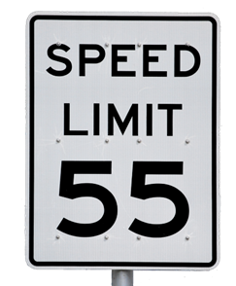
Quiz: Why is at- risk behavior the biggest threat to safety?
Human errors are often single events or failures
Reckless behavior rarely occurs
At risk behaviors can become habitual and pervasive
All of the above
Notes:
Most industry experts believe that at-risk behaviors represent the greatest threat to safety. All three of these behaviors could lead to bad outcomes. But a human error – genuine slip lapse or mistake – are typically single events or failures.
When it comes to reckless actions, we will often honor our perception of risk and not do that act; we will sometimes push forward with the behavior for various reasons, but not often.
In contrast, at-risk behaviors often become habitual, due to a lack of adverse outcomes associated with the choice. Often, an at-risk behavior becomes associated with an unwanted outcome only after an event has occurred. And these at-risk behaviors often become modeled by others, increasing the danger beyond the scope of just one person

Slide 56
Exercise: How/why do at- risk behaviors become habitual and pervasive?
As humans, we drift from safe behavior
Nothing bad happened before (risk not recognized)
This is the way we’ve always done it
Everyone else does it
“Incentives” may exist for at-risk behavior
Compliance with safe practices is not the priority
Compliance with safe practices is not the standard
Compliance with safe practices is not monitored
Compliance with safe practices is not enforced
What you permit,
you promote.
Notes:
ANIMATED SLIDE – PULL UP THE QUESTION FIRST. Ask participants to brainstorm around this question. Put answers on a white board and generate discussion. What is a common name for “at-risk” behavior? “Policy not followed”. AFTER PARTICIPANTS HAVE PROVIDED ANSWERS, PULL UP THE REST OF THE SLIDE.
Incentives may include short cuts, workarounds, time/production pressure, competing priorities, system design,
Performance shaping
If at risk behaviors are not managed, they will become pervasive and will eventually lead to an adverse outcome. People have drifted from safe behavior and this has become “the way things are done around here”. What you permit, you promote – regardless of outcome…

Slide 57
Results from NCPS Just Culture Collaborative 2015 - 2017
Employee behaviors contributing to events reported to NCPS during the Just Culture Collaborative
Notes:
This is NCPS data from a collaborative that was conducted with about a dozen Nebraska hospitals. We see that reckless behavior truly is not frequent.
However if we take human error and at-risk behavior together, that accounts for 97% of the events.
So when we think about managing human behavior in the context of an organization, and mitigating risk, we need to understand what is behind the behaviors.
What is the intent? What is behind the behavior? What system factors may have contributed to the error or drift?
Also recognize that if 30% of behaviors are at risk, what role does culture play in permitting this at-risk behavior?

Slide 58
Objective 8
Apply the subjective and objective (i.e. substitution test) perspectives to determine what happened during an event as compared to what usually happens.

Slide 59
Skill 3: Make Better Choices
1. ALIGN VALUES & EXPECTATIONS
2. DESIGN BETTER SYSTEMS that account for human fallibility
Future Focus
Future Focus
3. MAKE BETTER BEHAVIORAL CHOICES
4. LEARN TO SYSTEMATICALLY LEARN
Severity of Outcome
Due to Error
5. FIND JUSTICE
Notes:
Just culture shifts the focus from errors and outcomes to system design, the level of risk we tolerate, and behavioral choices. As Leaders, we need to know how to respond to errors and the range of behaviors appropriately, fairly, and consistently. Using the JC Algorithm is a tool that helps us learn to improve our systems our behavioral choices and change our perceptions of risk. Let’s start by considering system design from three different perspectives or “voices.”

Slide 60
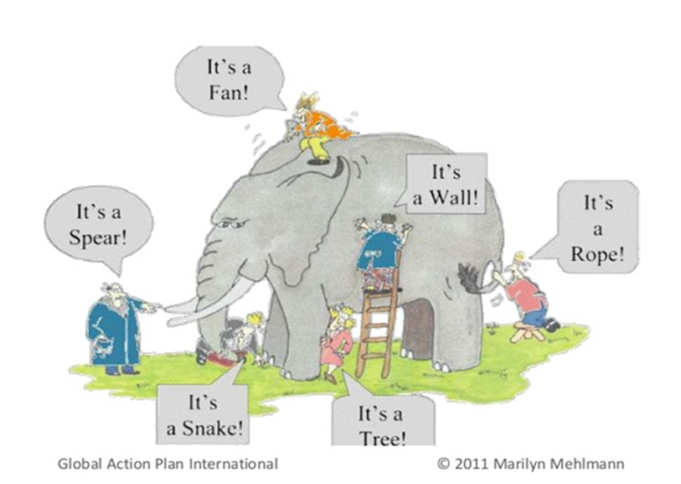
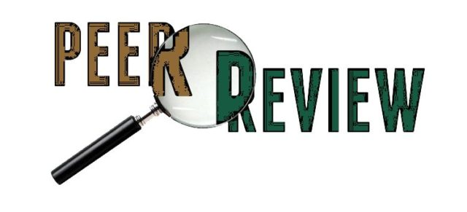
The three “voices”
L
LEADER
Determines mission and values
Determines risk and tolerability
Sets and enforces the rules, determines justice
S
SUBJECTIVE STANDARD
Legal standard that is specific to a particular person and based on the person’s individual views and experiences.
O
OBJECTIVE STANDARD
Legal standard: Reasonable Person Test
What would a “similar person, similarly situated” in your or a similar organization have done? The “substitution test”
This Photo by Unknown Author is licensed under CC BY-NC-ND
Notes:
There are three voices used to determine when someone has crossed the line from at-risk to reckless – or to knowingly causing harm or intentionally causing harm.
Leader or imposer – determines adherence to mission and values.
Subjective – the person’s voice – here remember the PIDA model as you try to understand their perspective. Perception, interpretation, decision, action – this often happens very quickly. People are usually thinking fast and reacting almost by routine and without stopping to “decide” something.
Objective - Reasonable person standard – substitution test. You decide in your organization who this is. Someone similarly situated.
Tip(s) for Instructor(s): Be prepared to handle a discussion of how to get the Objective Standard; it might be in conversation, it might be through observation, etc.
Leader – beware of outcome bias and inserting your own personal experiences into the evaluation. Use values, policy, phone a friend (leader).
Objective standard, we hope to understand what a reasonable, similarly situated person might do – be careful of the personal bias or past experiences of the “objective” person. Especially if there is an outcome that is known – that can cloud the objectivity. Armchair quarterback.

Slide 61
Crossing the line
Outcome – Is it your intent to cause harm?
Purpose: conscious objective to cause harm?
Knowledge: do you know that harm is practically certain to occur if you behave as you intend?
Conduct – What did you do?
Reckless
At-Risk Behavior
Human Error
“The Reasonable Person”
Notes:
We can use the Reasonable Person Standard to help us draw the line and separate at-risk behaviors from reckless behaviors.
Can you think of examples of reckless behaviors in sports that cross the line and are not allowed? Football? Face mask – spearing? Someone is likely to be harmed!
How about in driving a vehicle. What is the difference between at risk and reckless?

Slide 62
Vanderbilt medication error
LEADER
L
What competing values were revealed by administration support of overriding the Accudose system to provide timely care?
What was the level of risk tolerance indicated by approving of overrides and not having a bar code scanner available in radiology?
S
SUBJECTIVE STANDARD
What did RaDonda perceive/interpret when she removed vecuronium instead of Versed from the Accudose?
When did she make a conscious decision that contributed to the error?
O
OBJECTIVE STANDARD
Given the background of frequent overrides of alerts, might a similar person, similarly situated have made the same error when obtaining the drug?
Would a similar person have omitted the 7 rights of drug administration at the bedside?
Notes:
Let’s apply these to the Vanderbilt case.

Slide 63
Workplace justice - We are all judges
Purpose
Intent to harm
At-Risk
Drift from safe behavior
Error
Unintended act or omission
Knowledge
Reckless
Intent to act, knowing harm will occur
Choice to gamble with the outcome
Each action has its own level of accountability
We do not expect perfection from humans – we expect safe choices
Employees see how the organization responds to each of these behaviors – this response shapes employee perceptions of workplace justice (i.e. just culture and safety culture) (Marx, 2019)
Notes:
To summarize, as we seek workplace justice we can use these definitions and categories to help us determine intent and culpability,
By using this model, we can develop a human centered approach to justice.
We are all judges. We all watch how the organization (leaders) reacts to each of these behaviors.
Examples:
Was an obstetrician sanctioned for an inescapable human error?
Is the disruptive behavior of the gynecologist being ignored by the organization?
How a society, how an organization, and how a peer review panel react to each of these levels of intention will shape the views of workplace justice.
Marx, D, 2019. Patient Safety and the Just Culture. Obstet Gynecol Clin N Am 46 (2019) 239–245
https://doi.org/10.1016/j.ogc.2019.01.003

Slide 64
Questions? Concerns? ideas?
Notes:
SECTION C
Guidance to Instructor(s): N/A.
Tip(s) for Instructor(s): N/A.
Instructor(s) Notes:

Slide 65
Objective 9
Practice using the Just Culture Algorithms to determine the just and fair response to an individual’s behavior and the role of system design in a fatal medication error scenario.

Slide 66
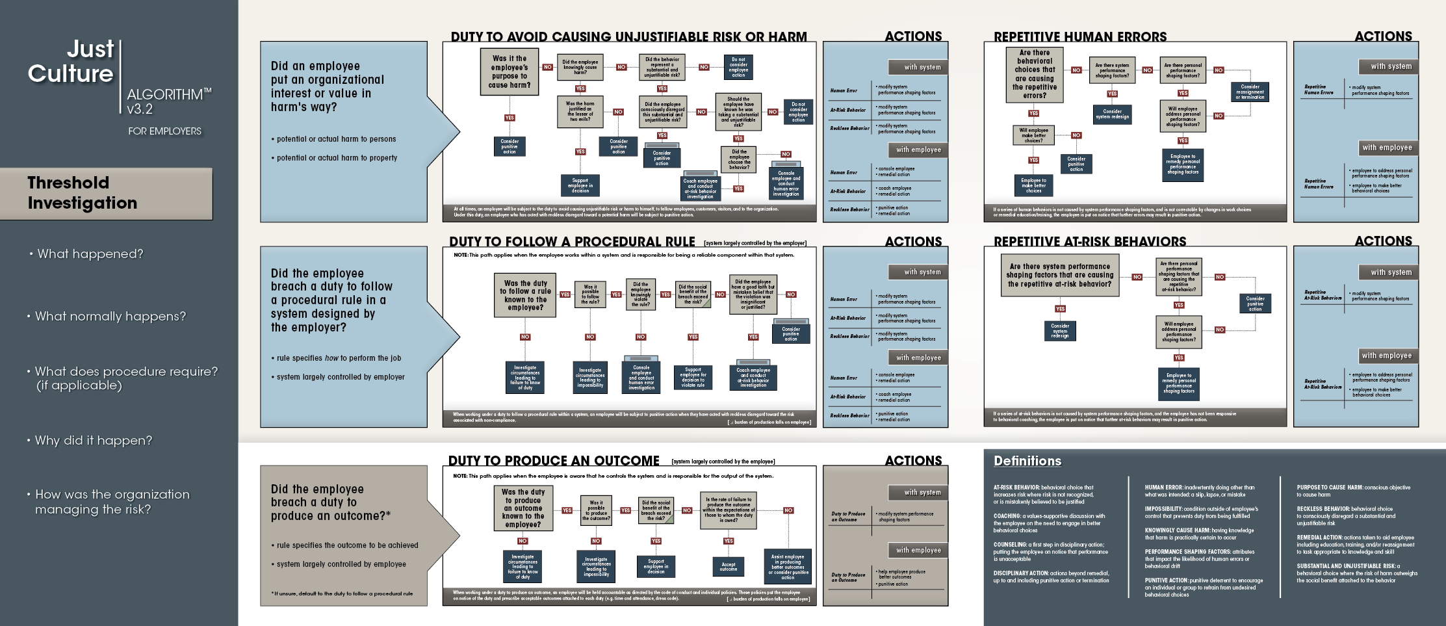
EVENTS = windows to understanding reliability of work processes and risk in system
Structured, consistent, fair approach to event investigation = learning from events = improved reliability = better outcomes
Notes:
You have been dealing with adverse events for as long as you have been a manager. However, you likely don’t know about most of your employee errors (does your boss know about all of your errors?) Many times, your people recognize the mistake, correct it, and move on without significant interruption.
At the other end of the spectrum are those adverse events that will receive a full-scale investigation because of their visibility, or the severity (or potential severity) of their outcome.
Each is relevant to your management of risk.
Each is a window into the reliability of your work process, a window through which you can learn about the factors that influence human error, at-risk behavior and reckless behavior.
Using a structured, consistent, and fair approach to event investigation will help you understand how to learn from events

Slide 67
Threshold investigation
What happened?
Increasing Value
What normally happens?
What does procedure require?
Why did it happen?
How were we managing it?
Notes:
We will walk through this structured approach to investigation, starting with the threshold investigation.
You begin the threshold investigation by asking these questions in this order…
This part of the Algorithm will be helpful for you to refer to each time you are called upon to review an event or near miss.
As we move through the investigation, there is increasing value to our learning, as we understand why something happened and how we were managing the risk.
The Role of Event Investigation (p. 49).
Tip(s) for Instructor(s): Recommend emphasizing that these are the pockets of information we seek; how we get this information is the art and skill of the investigation and may be talking, observing, gathering data, etc.

Slide 68
Threshold investigation
What happened?
Subjective standard
Interview person(s) involved in the event
Tell them how you will use the information
Use open-ended questions
Let them tell their story about what happened
Listen
Review any related documentation looking for the facts
Notes:
What happened? Generally, you will begin with your knowledge of only two things: the undesirable outcome and the last person involved before things went wrong.
This person is your key to unlocking the mystery of “what happened.”
They need to be interviewed – but carefully. Ease the employee’s stress by telling them how you will use the data.
Begin with open-ended questions, allowing the employee to tell her view of the error and adverse event. Simply start by asking, “What happened?”
During this first step, your employee should be doing most of the talking – you should be listening.
Look for the subjective standard.

Slide 69
Threshold investigation
What normally happens?
Interview the person involved
Walk you through the process
How is this job/action usually performed?
What is “the norm”?
Interview a similarly situated person – same questions as above
Look for the objective or reasonable person standard
Perform the “substitution test”
Tell them how you will use the information
Use open-ended questions
Let them tell you about how the process is currently working
Listen
The “norm” is not the reason why a violation occurred; instead it can tell you the prevalence of the behavior
Notes:
What normally happens? What normally happens is often referred to as the “norm.”
This will shed light on how employees are generally performing the task and the reliability of the task or process under investigation.
You can begin to understand the norm asking the person involved, and others who do this work, to walk you through the process – telling and/or showing you how the work is usually performed.
Through these conversations about how the work is generally performed, you might begin to identify factors that increase the likelihood of future adverse events.
Again, the person involved in the event may have no idea why he or she made a mistake – it may be that the employee will say that what normally occurs is exactly what did occur in this case – except for the error, of course.
Look for the objective standard.

Slide 70
Threshold investigation
What does procedure require?
Why wait to ask this now? Why not ask this first?
Ask someone not involved in the event
Look it up
This will tell you:
What was supposed to happen
How the system was designed to work
What else might this tell you?
Notes:
What does procedure require?
Why wait to ask this until now – why not ask this first? Because to begin by asking what policies and procedures require immediately shuts down effective communication.
Your job is to find out what happened – what was supposed to happen can wait until you have collected the facts about what did happen. You can also look this up or ask someone else not involved in the event what the procedure requires.
At this point, you should have three mental models of the process under investigation.
First, you know what happened in this event.
Second, you know how those who perform the task every day usually do it.
And lastly, you know what the procedure requires – how the system was designed to work.

Slide 71
Threshold investigation progress 3 mental models to Compare
What happened in this event
How the task is normally done
How the system was designed to work
Notes:
At this point, you should have three mental models of the process under investigation.
First, you know what happened in this event.
Second, you know how those who perform the task every day usually do it.
And lastly, you know what the procedure requires – how the system was designed to work.

Slide 72
housekeeping
A housekeeping worker was waxing the floors around 10:00 p.m. He could not find a wet floor sign and would have had to go to another building to search for one. Believing he was alone in the building, he did not search for a warning sign.
The Chief Financial Officer slipped on the wet floor and severely damaged his knee. The housekeeping staff frequently had to search for the wet floor warning signs which caused them to get behind on their work. The housekeeping manager was aware of the unavailability of signs, but did not take any action to purchase more.
No Wet Floor Sign: Answer the first 3 Threshold Questions
Notes:
Let’s practice this part of the threshold investigation…
Ask someone to read this scenario.
Go through first 3 threshold questions regarding the fact that there was no wet floor sign placed. Talk about breach of duty – what duty was breached by not placing a wet floor sign? (duty to follow a procedure – duty to not cause harm)
What happened?
What normally happens?
What does procedure require? (ask manager?)
Guidance to Instructor(s): To be done as a class led by the instructor. Recommend identifying all possible breaches of duty (1) no wet floor sign; (2) manager did not purchase more signs; (3) CFO on site at 10pm. Discuss how all of them will go through the 5 questions, but due to lack of information recommend only walking the no wet floor sign through the questions in their entirety.

Slide 73
Threshold investigation
Why did it happen?
Begin looking for causes (not blame)
Remember that a person who has erred may not know why they have erred
Seek to understand the process so you can see the risks involved
Identify factors that shape human performance including system design
Notes:
Before you get further into your investigation, there are some basic investigative rules critical to a productive event investigation. Review rules of causation – used in a RCA.
Why did it happen? Looking for risks in the system – not blame.

Slide 74
Human Performance shaping factors
FACTORS THAT INFLUENCE HUMAN PERFORMANCE
INTERNAL | EXTERNAL | SYSTEM
INDIVIDUAL | ENVIRONMENT | SYSTEM
ALERTNESS | LIGHTING | COMPUTER-HUMAN INTERFACE
ANXIETY, STRESS, ILLNESS | NOISE | TASK COMPLEXITY
KNOWLEDGE OF TASK, PROCESS, SYSTEM, RULES | FAMILIAR? | CULTURE
HEARING ABILITY | DISTRACTIONS | WORKLOAD PRESSURE
CONFIDENCE | LOOK ALIKE, SOUND ALIKE | TOOL DESIGN
ATTENTIVENESS, CONCENTRATION | PEER PRESSURE | WORKPLACE LAYOUT
Outcome Engenuity, 2018

Slide 75
Skill 5: Find Justice
1. ALIGN VALUES & EXPECTATIONS
2. DESIGN BETTER SYSTEMS that account for human fallibility
Future Focus
Future Focus
3. MAKE BETTER BEHAVIORAL CHOICES
4. LEARN TO SYSTEMATICALLY LEARN
Severity of Outcome
Due to Error
5. FIND JUSTICE

Slide 76
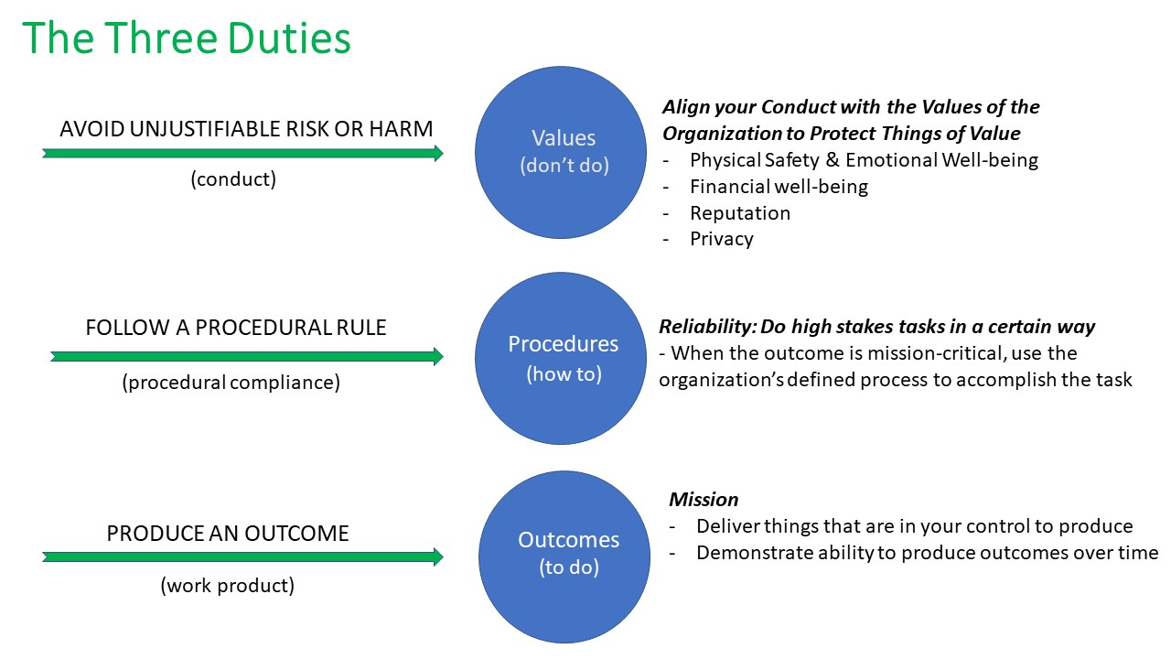
The Three duties
Notes:
This graphic is a concise depiction of the 3 duties and what they cover.

Slide 77
Notes:
Each breach of duty will go through one of these three algorithms:
Duty to Avoid Causing Unjustifiable Risk or Harm
Duty to Follow a Procedural Rule
Duty to Produce an Outcome
There is no wrong algorithm selection. However, there is a best fit algorithm. An example of this would be if you found that an employee had falsified records to appear as if they had completed annual safety training when they had not. You might at first think it was a breach of a Duty to Produce an Outcome. Yet if there is a single breach that you view as inexcusable, you are probably seeing culpable conduct that should be evaluated under the duty to avoid causing unjustifiable risk or harm

Slide 78
duty to avoid causing unjustifiable risk or harm “Don’t do”
Notes:
This duty
is considered to be the higher obligation and takes precedence over the other duties.
applies all of the time and it is owed to everyone we encounter (not to put each other at unreasonable risk – whether that risk be economic, reputation, or physical safety.
At any time you believe your employee has breached their duty to avoid causing unjustifiable risk or harm you should use the algorithm (whether someone was actually harmed, or was just put risk of harm). That someone can be a fellow employee, a customer, or the organization as a whole.
Before you begin the algorithm you need to identify 3 things:
the conduct (what was the unjustifiable risk or harm. Generally, the harm will be either injury to persons or to property. Did the employee take a risk of personal injury or financial harm?)
the value the conduct encroached upon
the potential harm caused by the conduct

Slide 79
Notes:
Embedded in this algorithm are the 5 behaviors (from purpose to cause harm to human error)
1st Question – we already identified that emotional stress and loss of teamwork resulted from the breach; emotional stress impacted the colleague and loss of teamwork the workgroup (each could be taken through the algorithm and could have a different outcome)
2nd Question – person didn’t set out to do harm but knew harm was virtually certain; “Me First” behavior; theft and cheating are good examples of the “Me First” behavior. It is unjustly getting ahead.
Knowingly Causing Harm can be the right thing (lesser of 2 evils) example: Firefighter knowingly hurting someone to remove them from a burning building (instead of letting them burn to death)
If the answer to Knowingly Causing Harm is “No” then you need to ask,
Was it Substantial?
Was it Unjustifiable?
Both questions must be answered “yes” to go on to the next question,
Was their a conscious disregard (technical definition states it is the conscious disregard of a substantial and unjustifiable risk); it is recklessness
Recognition of the risk in the person’s brain (we recognize the risk but choose it anyway) e.g. Driving 35 miles above the speed limit and weaving in and out of traffic
Conscious disregard of the risk, not of choosing a behavior (e.g. the disregard caused them to behave in a certain way) Discussion of subjective risk?
Should they have known they were taking a substantial and unjustifiable risk?
Coaching is not disciplining – it is helping them understand and “see” the risk that they did not see (could be duplication of another slide)

Slide 80
Hand hygiene protocol not followed
Avoid Causing Unjustifiable Risk or Harm
A food services worker walks by a patient room, seeing the patient about to fall from his bed she quickly runs into the room, lifting the patient back on the bed before the patient falls. In doing so, the food services worker failed to follow hospital protocol which requires performing hand hygiene before touching a patient. A coworker saw the event occur and filed an incident report because they were concerned about infection control.

Slide 81
S
O
,,
Breaking a rule does not always mean the person’s behavior is substantially and unjustifiably risky!
Notes:
The Justice Culture model is a value based system of justice. An organization’s shared values should be what guides those working there. You could state this as Values supersede rules. A rule cannot be written for every circumstance, so trying to do the right thing is what should guide us.
Example: A sign is posted on a lawn that says, Keep Off the Grass, and yet you see an injured bicyclist lying on the law. You should offer help to the person because the value of offering aid supersedes the rule.
Another example to take through this algorithm would be not completing the sponge count in Surgery prior to closing the wound. Where would this end? (Reckless Behavior)

Slide 82
duty to follow a procedural rule “How To”

Slide 83
Inoperable pump
Follow a Procedural Rule
The Biomed Department has a large book in which the instructions for repairing equipment are located. Policy requires that these instructions be followed each time that a repair was performed. Last week a technician made a mistake on the repair of an infusion pump by omitting a required check upon re-assembly of the pump (relying on his memory to perform the task). This check, called out in the manual, would have confirmed that the infusion pump would not allow the free (unregulated) flow of medication under a particular failure mode of the pump. The inoperable pump safety device was caught when a patient received a free flow of medication, leading to the death of the patient. Investigation reveals that the technician regularly performs this specific maintenance. Investigation also reveals that other technicians were performing this task by memory, without the aid of the procedure manual.

Slide 84
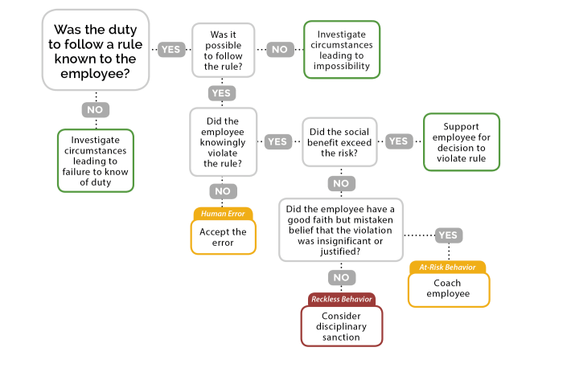

Slide 85
duty to produce an outcome “To Do”
Notes:
Refers to that set of duties where the employee is accountable for an outcome. In this part of the algorithm none of the 5 behaviors appear, you are just looking for a result
In the employment environment, duties to produce outcomes include time and attendance, proper attire, the obligation to complete job tasks, attend meetings, to name just a few.
These expectations for results must also come with a rate of acceptable breach – the number of times your employee can miss the mark and you are prepared to accept the outcome, continue to monitor rate, and move on.

Slide 86
Flu shot
Produce an Outcome
The organization requires all employees to get a flu shot no later than November 1st each year. Flu shots are offered on campus for both staff and the general public from September 15th through November 15th.
A manager has eight team members, and all but one person got their flu shot by the deadline. The manager approaches this employee on November 2nd for clarification. The employee says he has been very busy both at work and at home. He kept meaning to get the flu shot but it just was not possible as things kept coming up.
The manager agrees to give him one more day to get the flu shot and encourages him to go during his lunch break.

Slide 87
Was the duty
to produce an outcome known
to the employee?
Was it possible to produce the outcome?
Investigate circumstances leading to impossibility
YES
NO
NO
YES
Investigate circumstancesleading to impossibility
Is the rate of failure within the expectation?
Accept
Outcome
Did the social benefit exceed the risk?
NO
YES
YES
NO
Support employee in decision
Can the employee reasonably and appropriately be helped?
Consider disciplinary sanction
NO
YES
Assist employee
in producing outcome
Notes:
For an outcome duty, there is always an expected rate. It could be production based (# of records reviewed, # of prescriptions filled) or failure based (# of absences from work in a specified period of time, # of missing or incorrect diagnosis codes assigned to a patient chart).
If you were to use this algorithm for an attendance problem you would find yourself answering, “No” to the question, Did the social benefit exceed the risk?
Next, “Is the rate within the expectation? and the “No” answer puts in you in the “Can the employee reasonably and appropriately be helped?” Anytime you find yourself in this box you will want to consider if the steps you would need to take are:
fair to the others in the workgroup?
a reasonable use of your available resources?
within your ability to help the employee?
Appropriate?

Slide 88
repetitive human errors and at-risk behaviors

Slide 89
Phlebotomy
A phlebotomist, who formerly worked for a blood bank, has worked at Community Hospital for two months. During this time, she has inadvertently left tourniquets on six patients after completing the blood draw and leaving the room. The tourniquets were all found by patients or nurses. Four of the patients did not sustain an injury, one patient lost the feeling in her arm temporarily, and another patient sustained a more serious injury.
At the blood bank where the phlebotomist previously worked, the procedure was to use blood pressure cuffs instead of tourniquets, to deflate them and leave them on the patients after the blood draw.
The hospital tourniquets are light blue, which is the same color as the patient gowns. The patient gown sleeves are long and often cover the tourniquets. There is not a standard number of tourniquets in the blood draw trays each day. The phlebotomist does the majority of the blood draws in the hospital and has to move quickly to complete them on time. The lab gets a lot of negative feedback from physicians when test results are not available when they make morning rounds.
The laboratory director has reminded the phlebotomist twice that she needs to remember to take the tourniquet off before leaving a room. After the fifth incident, the laboratory director warned the phlebotomist that any more mistakes could result in losing her annual bonus. The laboratory director does not know how to respond to this ongoing problem.
The phlebotomist’s performance at the blood bank was stellar and she came with highest recommendations. In fact, she was a lead member of a major quality improvement project there. She has recommended some process changes to the lab director at Community Hospital, but he insists that the process isn’t the problem.
Source: Nebraska Coalition for Patient Safety

Slide 90
Repetitive Human Error

Slide 91
Cautery burn
When the drapes were removed from the patient after a surgical procedure, a small burn mark was noted on the drapes and then a burn was found on the patient’s abdomen. The surgical safety protocol calls for the surgeon to place the cautery tip in the cautery holster after use.
During the investigation, both the circulating nurse and the surgical tech reported that the holster was placed in its usual place, within sight and reach. They reported that the surgeon did not use the holster in this case. Upon further questioning, they noted that this surgeon often throws down the cautery when he is done with it, rushes through cases, is not approachable and can’t be redirected.
The surgeon initially said he uses the holster most of the time, but today it was positioned in an area that he isn’t used to. He later stated he didn’t like using the holster, that most of the surgeons don’t use it and they don’t want to use it.
Source: Nebraska Coalition for Patient Safety

Slide 92
Repetitive at risk behaviors
Notes:
What are some other examples of at-risk behaviors that may be repetitive?
Use bar code scanner for medications as an example.

Slide 93
Threshold investigation
What happened?
Increasing Value
What normally happens?
What does procedure require?
Why did it happen?
How were we managing it?
Notes:
When we better understand why a specific outcome occurred, we can better understand how we were managing the risks associated with the process and what gaps and workarounds might exist. It helps us better understand the risk and learn how to do better in the future.
Refer back to phlebotomy case and/or cautery burn case for discussion if needed.

Slide 94
Threshold investigation
How were we managing it?
Use the investigation as a window to risk
What did you discover as you searched for causes?
What was the system design around risk?
Reliance on human vigilance?
System complexity contributing to workarounds?
Performance shaping factors within the system?
Competing priorities?
Event investigation is reactive/retrospective
How is our system currently operating related to risk?
Notes:
How was the organization managing the risk?
It is important in any investigation for the manager to think about how the organization, or the manager specifically, was managing the risk being investigated.
Were we relying on the employee simply not to make the mistake?
Did we rely on recovery or redundancy in a more robust system design?
What was the system design around risk?
After all, investigation is meant to be a window to risk – a window that should allow you to see how robust of the system around your employee.
How is our system currently operating related to risk? What are the gaps – opportunities to improve?

Slide 95
Threshold investigation: Vanderbilt Medication Error
What happened?
Increasing Value
What normally happens?
What does procedure require?
Why did it happen?
How were we managing it?
Notes:
Vanderbilt medication error case:
Recall that we will begin the investigation by walking through the first 3 questions for the scenario provided. Why did this event happen...go on to causal map....
Then come back to How were they managing the risk
How was the organization managing risk in this case? What system factors contributed to the risk for error or allowed an individual to make a choice that may not have been safe?
Do we know yet why this happened? Was it an error? Was it a behavioral choice? What is the “norm”? What is the objective standard?

Slide 96
WHY
ADC only required 2 letters, defaulted to generic
Timeline
Nurse from unit chose drug based on VE
Radiology did not want to give medication
Over-rides were common, expected due to recent EHR-ADC update
Nurse over-rode alert
Outcome
Multitasking (precepting)
Nurse did not look at vial
Patient dies after receiving the wrong medication (a paralytic) in radiology
BCMA not available in radiology
Nurse administered medication without verifying 7 rights
Behavioral drift
Nurse needed back on the floor, was precepting
Nurse did not monitor pt. after administering drug
Thought drug was Versed
Radiology did not notice change in pt. status for 25 minutes
Relies on camera surveillance

Slide 97
Which Duty?
Notes:
Was her risk monitor firing?
We don’t think RaDonda consciously disregarded this substantial and unjustifiable risk
Now let’s walk through using the algorithm to determine whether any breach in duty occurred.
All three duties may apply...
Default to duty to avoid unjustifiable risk or harm...did she consciously disregard the risk? She chose the behavior (to give medication without checking 7 rights, to not monitor the patient).
What did you find? Discuss using the algorithm for the scenario provided. Where does accountability lie? For the nurse? For the organization? What is the appropriate response?

Slide 98
Five Skills Support Just Culture
Who is accountable for each skill?
1. ALIGN VALUES & EXPECTATIONS
2. DESIGN BETTER SYSTEMS (to account for human fallibility)
3. MAKE BETTER BEHAVIORAL CHOICES
4. LEARN TO SYSTEMATICALLY LEARN
Severity of Outcome
Due to Error
5. FIND JUSTICE
Notes:
Outcomes (positive or negative) are determined by the interaction between system design, risk we are willing to tolerate, and behavioral choices.
When an error happens, what is your current focus...the severity of the outcome or the system that produced the error
This is the model you will learn to change your culture from a focus on errors as outcomes, to a focus on the structures and processes such as system design, risk, and behavioral choices that produce those outcomes A key principle is to change the organization’s focus from errors as outcomes, to an analysis of how system design, risk, and behavioral choices produces those outcomes.
Risk = likelihood of an event x severity of the event.
>There are 5 specific skills needed to support a just culture and achieve better outcomes. Reflecting the principle of shared accountability... Managers are primarily accountable for skills .... 1,2,3,5 and employees are accountable for 4.

Slide 99
Opportunities for improvement
How to Investigate
Three Duties
Three Behaviors
How to Respond
What managers need to know/do
What staff need to know/do
Produce Outcome, Follow Rule, Avoid Harm
Human Error, At-Risk, Reckless

Slide 100
Leaders Knowledge of Just Culture
3 Just Culture Champions
18/21 Managers/Leaders reported being trained to use Just Culture Algorithm
BBGH Hospital Survey on Patient Safety Culture 2.0, April 2022 | % Correct
 | Mgt | Non-mgt
What are the three categories of behavior managers identify from the perspective of a just culture? (Answer: Human error, At-risk behavior, Reckless behavior) | 62% | 11%
Which of the following is NOT a duty employees are responsible for in a just culture? (Answer: Duty to provide quality care)* | 29% | 4%
What are the three management responses to employee actions in a just culture? (Answer: Console, Coach, Punish) | 38% | 3%
During the investigation phase, what perspectives are used to determine what happened and what would normally happen? (Answer: Subjective/Objective) | 33% | 8%
*Duties are: (1) produce an outcome, (2) follow procedural rules, (3) avoid causing unjustifiable risk or harm
Notes:
Where do you need to focus your training efforts?

Slide 101
staff perceptions of Just Culture
Response Scale: Strongly Disagree to Strongly Agree
(R) = Reverse-worded item; score is the percent that Disagreed/Strongly Disagreed
BBGH Hospital Survey on Patient Safety Culture 2.0, April 2022 | What action will improve perceptions of each item?
Response to Error
In this unit, staff feel like their mistakes are held against them. (R)
When an event is reported in this unit, it feels like the person is being written up, not the problem. (R)
When staff make errors, this unit focuses on learning rather than blaming individuals.
In this unit, there is a lack of support for staff involved in patient safety errors. (R)
Notes:
How should leaders respond to mistakes? (console and modify system)
How should leaders/the organization respond when events are reported?

Slide 102
Learning Culture Objectives
Participate in an active learning activity to experience how briefs and debriefs impact team performance.
Use results from your 2022 Hospital Survey on Patient Safety Culture to identify opportunities for improvement in unit/department leadership and learning.
Compare/contrast debriefs and root cause analysis as learning tools to improve system performance.
Recognize debriefs as a team leadership strategy that is integral to all other components of the teamwork system.
Explain the structure and organizational context of effective debriefs in which the goal is to improve system outcomes.
Describe the steps and attributes of a thorough, credible, acceptable root cause analysis and action plan.
Identify Next Steps needed to implement Just Culture and Debriefs as leadership strategies in your organization.
Notes:
Practice using the algorithms requires recognition of employee behavioral choices and duties and application of subjective and objective scenarios, and system redesign.
Decided to leave the morning focus on Just Culture and leave the discussion of leaders until after the Active Learning with the blocks. We will pull it all together ... how the JC Algorithm, debriefs, and RCA are all learning tools ... at the end. Then finish with a discussion of barriers to implementing the tools.

Slide 103
Obj 1. Active Learning
Organize into teams of 4 – 5 people
Find a flat surface to work from
When you are ready, we will take 1 minute to read the instructions on the next slide
Notes:
Create teams of 4-5 people.
You will have 1 minute to read these instructions.

Slide 104
Active Learning
Goal: You have 1 minute to build the tallest tower.
Rules:
Blocks are located at the front and back of the room.
Runners retrieve blocks from bins but may only take 5 blocks at a time.
Builders build the tower using the pattern of 1 large, 3 small blocks, repeat.
No two blocks of the same color may touch.
Runners are not allowed to build/ builders are not allowed to run.
Any unused blocks that are not replaced in the storage bins before time is called will be subtracted from the tower height; one block subtracted for each unused block.
Report Out: Height of tower in blocks (minus unused blocks).
Notes:
Create teams of 4-5 people.
You will have 1 minute to read these instructions.

Slide 105
Learn and Improve
Debrief (2-3 minutes)
What went well?
What didn’t go well?
What will you do differently?
Report your conclusions to the group
Debriefs are an essential team strategy that ensures team members learn from their experience. Effective teams meet to debrief regularly…after unexpected outcomes to understand what went wrong and why and after especially good outcomes to understand what went well and why.
Notes:
Tell the students to spend 2 – 3 minutes discussing in small teams:
What went well?
What didn’t go well?
What will we do differently?
Ask each team for their conclusions.
Typical conclusions about what didn’t go well will include:
We didn’t pay attention to the time
We didn’t think about how subtracting the unused blocks would affect our goal
The runners brought too many blocks
We didn’t have a strategy to follow the pattern quickly
Summarize the key points to the larger group.
When human beings engage in a new activity, they are often task-focused; novices often focus narrowly on their own task without seeing the bigger picture of the team goal.
Runners may have made as many trips as possible without monitoring the builders’ progress.
Builders may have focused on the complexity of the pattern without monitoring how many blocks piled up on the table.
Because they were task-focused, neither the runners nor the builders kept track of the time, which was part of the goal
In the language of team science, being task-focused results in a “loss of situational awareness”… basically, you lose sight of the big goal.
Give all teams ~ 1.5 min to brief in preparation for their repeat building activity.
Facilitator:
Tell the students that they will have a second opportunity to achieve their goal, but this time they will have a chance to apply what they just learned in the debrief by conducting a brief.
Describe that a brief is “a team strategy that ensures team members have a shared mental model”…that they are all on the same page…about their goal and how each team member’s unique skill set can contribute to the goal. Briefs are typically called by a designated leader who is accountable for ensuring that the team has the resources needed to achieve the goal and that the workload is distributed. Effective teams brief at the beginning of a new activity, shift, or day.
Use the slide above as a guide. Have students conduct the brief with their small group for 1 – 2 minutes by discussing…
Do we understand the goal?
Do we understand how each role contributes to the goal?
Do we have the resources we need?
Workload distributed?
Remind students to think about the specific roles and responsibilities needed to achieve the goal, which is time limited. Do NOT specifically tell them to assign a timekeeper role
Go to the next slide, after students have had about 1 minute to complete their brief.

Slide 106
Learn and Improve
Key Points
When human beings engage in a new activity, they are often task-focused; novices often focus narrowly on their own task without seeing the bigger picture of the team goal.
Runners may have made as many trips as possible without monitoring the builders’ progress.
Builders may have focused on the complexity of the pattern without monitoring how many blocks piled up on the table.
Because they were task-focused, neither the runners nor the builders kept track of the time, which was part of the goal
In the language of team science, being task-focused results in a “loss of situational awareness”… basically, you lose sight of the big (TEAM) goal.
Notes:
Tell the students to spend 2 – 3 minutes discussing in small teams:
What went well?
What didn’t go well?
What will we do differently?
Ask each team for their conclusions.
Typical conclusions about what didn’t go well will include:
We didn’t pay attention to the time
We didn’t think about how subtracting the unused blocks would affect our goal
The runners brought too many blocks
We didn’t have a strategy to follow the pattern quickly
Summarize the key points to the larger group.
When human beings engage in a new activity, they are often task-focused; novices often focus narrowly on their own task without seeing the bigger picture of the team goal.
Runners may have made as many trips as possible without monitoring the builders’ progress.
Builders may have focused on the complexity of the pattern without monitoring how many blocks piled up on the table.
Because they were task-focused, neither the runners nor the builders kept track of the time, which was part of the goal
In the language of team science, being task-focused results in a “loss of situational awareness”… basically, you lose sight of the big goal.
Give all teams ~ 1.5 min to brief in preparation for their repeat building activity.
Facilitator:
Tell the students that they will have a second opportunity to achieve their goal, but this time they will have a chance to apply what they just learned in the debrief by conducting a brief.
Describe that a brief is “a team strategy that ensures team members have a shared mental model”…that they are all on the same page…about their goal and how each team member’s unique skill set can contribute to the goal. Briefs are typically called by a designated leader who is accountable for ensuring that the team has the resources needed to achieve the goal and that the workload is distributed. Effective teams brief at the beginning of a new activity, shift, or day.
Use the slide above as a guide. Have students conduct the brief with their small group for 1 – 2 minutes by discussing…
Do we understand the goal?
Do we understand how each role contributes to the goal?
Do we have the resources we need?
Workload distributed?
Remind students to think about the specific roles and responsibilities needed to achieve the goal, which is time limited. Do NOT specifically tell them to assign a timekeeper role
Go to the next slide, after students have had about 1 minute to complete their brief.

Slide 107
Learn and Improve
Briefs are a team strategy that ensures team members have a shared mental model…that they are all on the same page…about their goal and how each team member’s unique skill set can contribute to the goal. Effective teams brief at the beginning of a new activity, shift, or day.
Brief (Clarify our plan)
Do we understand the goal?
Do we understand how different roles contribute to the goal?
Do we have the resources we need?
Workload distributed?
Notes:
Define a team debrief as “an essential team strategy that ensures team members learn from their experience. Effective teams debrief regularly…after unintended outcomes to understand what went wrong and why and after especially good outcomes to understand what went well and why.”
Tell the students to spend 2 – 3 minutes discussing in small teams:
What went well?
What didn’t go well?
What will we do differently?
Ask each team for their conclusions.
Typical conclusions about what didn’t go well will include:
We didn’t pay attention to the time
We didn’t think about how subtracting the unused blocks would affect our goal
The runners brought too many blocks
We didn’t have a strategy to follow the pattern quickly
Summarize the key points to the larger group.
When human beings engage in a new activity, they are often task-focused; novices often focus narrowly on their own task without seeing the bigger picture of the team goal.
Runners may have made as many trips as possible without monitoring the builders’ progress.
Builders may have focused on the complexity of the pattern without monitoring how many blocks piled up on the table.
Because they were task-focused, neither the runners nor the builders kept track of the time, which was part of the goal
In the language of team science, being task-focused results in a “loss of situational awareness”… basically, you lose sight of the big goal.
Give all teams ~ 1.5 min to brief in preparation for their repeat building activity.
Facilitator:
Tell the students that they will have a second opportunity to achieve their goal, but this time they will have a chance to apply what they just learned in the debrief by conducting a brief.
Describe that a brief is “a team strategy that ensures team members have a shared mental model”…that they are all on the same page…about their goal and how each team member’s unique skill set can contribute to the goal. Briefs are typically called by a designated leader who is accountable for ensuring that the team has the resources needed to achieve the goal and that the workload is distributed. Effective teams brief at the beginning of a new activity, shift, or day.
Use the slide above as a guide. Have students conduct the brief with their small group for 1 – 2 minutes by discussing…
Do we understand the goal?
Do we understand how each role contributes to the goal?
Do we have the resources we need?
Workload distributed?
Remind students to think about the specific roles and responsibilities needed to achieve the goal, which is time limited. Do NOT specifically tell them to assign a timekeeper role
Go to the next slide, after students have had about 1 minute to complete their brief.

Slide 108
Active Learning
Goal: You have 1 minute to build the tallest tower.
Roles:
Rules:
Blocks are located at the front and back of the room.
Runners retrieve blocks from bins but may only take 5 blocks at a time.
Builders build the tower using the pattern of 1 large, 3 small blocks, repeat.
No two blocks of the same color may touch.
Runners are not allowed to build/ builders are not allowed to run.
Any unused blocks that are not replaced in the storage bins before time is called will be subtracted from the tower height; one block subtracted for each unused block.
Report Out: Height of tower in blocks (minus unused blocks).
Notes:
Create teams of 6-8 people.
You will have 1 minute to read these instructions.

Slide 109
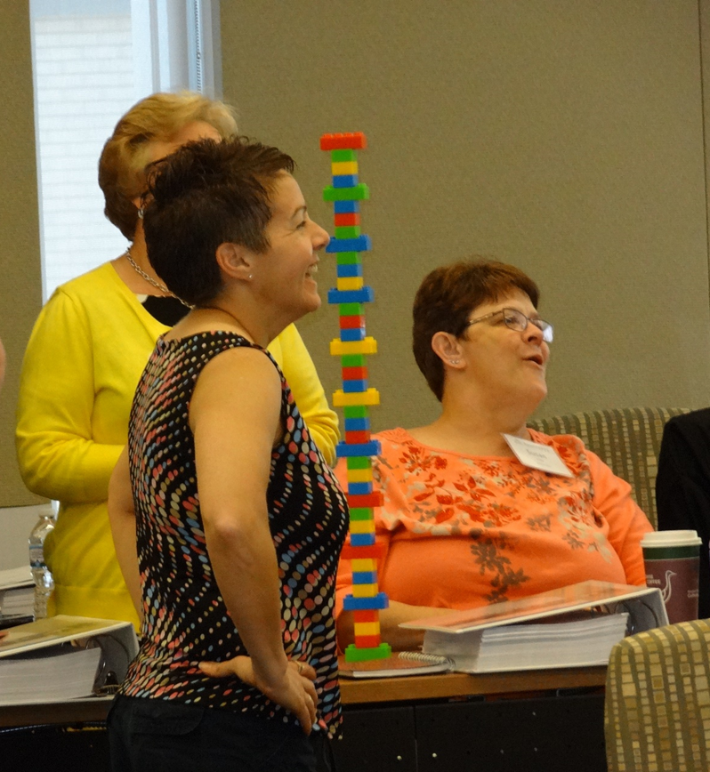
Learn from Experience
Debrief
What went well?
What didn’t go well?
What will you do differently?
This exercise was developed by the University of Washington Institute for Simulation Interprofessional Studies—one of six TeamSTEPPS National Training Centers
http://isis.washington.edu/services/teamstepps/teamstepps_external_training_program .
It was modified and expanded by Katherine J. Jones, PT, PhD
Notes:
Define a team debrief as “an essential team strategy that ensures team members learn from their experience. Effective teams debrief regularly…after unintended outcomes to understand what went wrong and why and after especially good outcomes to understand what went well and why.”
Tell the students to spend 2 – 3 minutes discussing in small teams:
What went well?
What didn’t go well?
What will we do differently?
Ask each team for their conclusions.
Typical conclusions about what didn’t go well will include:
We didn’t pay attention to the time
We didn’t think about how subtracting the unused blocks would affect our goal
The runners brought too many blocks
We didn’t have a strategy to follow the pattern quickly
Summarize the key points to the larger group.
When human beings engage in a new activity, they are often task-focused; novices often focus narrowly on their own task without seeing the bigger picture of the team goal.
Runners may have made as many trips as possible without monitoring the builders’ progress.
Builders may have focused on the complexity of the pattern without monitoring how many blocks piled up on the table.
Because they were task-focused, neither the runners nor the builders kept track of the time, which was part of the goal
In the language of team science, being task-focused results in a “loss of situational awareness”… basically, you lose sight of the big goal.

Slide 110
Objective 2
Use results from your 2022 Hospital Survey on Patient Safety Culture to identify opportunities for improvement in unit/department leadership and learning.
Notes:
Our first objective is to...

Slide 111
What Role do Leaders Play?
Safety culture is a result of the actions that leaders take to ensure that staff learn from their experience. Leaders implement the culture and close the gap between beliefs and behaviors by...
What they regularly pay attention to, measure, and control
How they react to adverse events and crises
How they allocate resources
How they role model, teach, and coach
How they provide feedback and rewards
Who they recruit, promote, and ignore
The language they use (Just Culture and TeamSTEPPS)
(Schein, 2010)
https://s.abcnews.com/images/Politics/WireAP_3e580095fd654b6a81d0ddd39ad160a7_16x9_992.jpg

Slide 112
Staff Perceptions of Unit Leader
Response Scale: Strongly Disagree to Strongly Agree
(R) = Reverse-worded item; score is the percent that Disagreed/Strongly Disagreed
BBGH Hospital Survey on Patient Safety Culture 2.0, April 2022 | Percent Positive Score
Supervisor/Manager/Clinical Leader Support for Patient Safety | Dept Min | Hosp Avg | Dept Max
My supervisor, manager, or clinical leader seriously considers staff suggestions for improving patient safety. | 44% | 73% | 100%
My supervisor, manager, or clinical leader wants us to work faster during busy times, even if it means taking shortcuts. (R) | 53% | 80% | 100%
My supervisor, manager, or clinical leader takes action to address patient safety concerns that are brought to their attention. | 52% | 75% | 100%
Notes:
1 and 3... Are you paying attention and taking action?
2....are you aligning expectations with values? Production vs protection?

Slide 113
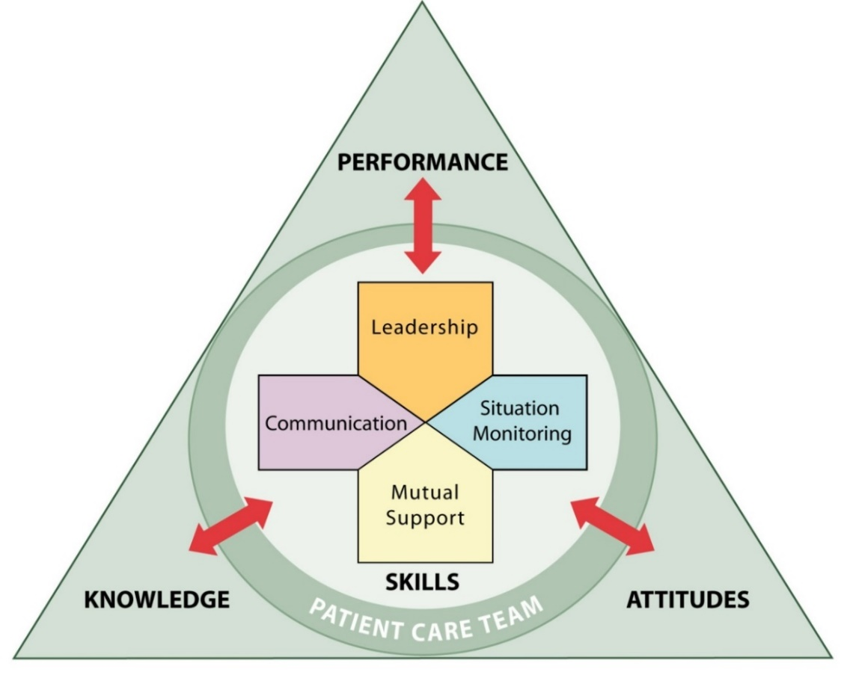
Leadership
Leaders
Two types of Leaders
Designated—Person assigned to lead and organize a team
Situational—Any team member who has the skills needed to manage a situation
Continuously monitor the situation
Manage resources
Provide feedback for improvement
Initiate team meetings (briefs, huddles, debriefs)
Ensure goals and roles are clear, tasks are delegated
Ensure team members feel psychologically safe to speak up about what is going on and to seek/offer task assistance

Slide 114
Leaders Start the Teamwork Process
Leaders bring team members together, est. goal, roles, psychological safety
Closed Loop Communication
Members monitor and share what is going on
Members ask for and offer help
Leadership
Team adapts due to a new shared mental model
Situation Monitoring
Mutual Support
Teams provide organizations with a greater ability to adapt and learn (be resilient) than do groups of individuals.
Team
Performance
(GOAL)
(Salas et al., 2005)
TRUST
Notes:
Briefs, huddles and debriefs are meetings that leaders use to initiate teamwork by clarifying roles, establishing goals & expectations, and organizing meetings for planning and feedback. During team meetings, team members have the opportunity to communicate what they have learned by monitoring others, a new shared mental model of how to reach a goal emerges, and team members offer back up behavior or mutual support to achieve that goal. When team members trust each other, use closed loop communication, and value team goals above individual goals; they have the ability to adapt, manage complex systems & patients and learn from experience. Teams provide organizations with a greater ability to adapt and learn than do individuals.

Slide 115
Staff Perceptions of Learning
Response Scale: Strongly Disagree to Strongly Agree
(R) = Reverse-worded item; score is the percent that Disagreed/Strongly Disagreed
BBGH Hospital Survey on Patient Safety Culture 2.0, April 2022 | Percent Positive Score
Organizational Learning – Continuous Improvement | Dept Min | Hosp Avg | Dept Max
This unit regularly reviews work processes to determine if changes are needed to improve patient safety. | 45% | 68% | 89%
In this unit, changes to improve patient safety are evaluated to see how well they worked. | 37% | 54% | 71%
This unit lets the same patient safety problems keep happening. (R) | 52% | 70% | 100%

Slide 116
Context of Errors (Pt. Safety Problems)
 |  | Interdependence
Process | Certain/Rule | Low (Individual Humans) | High (Groups/Teams)
 |  | Task Execution: Individuals fail to perform well understood, routine tasks that require vigilance; they make a human error (slip/lapse) Examples: Forget to turn on bed alarm, use gait belt, put up top bed rails; confuse look-alike/sound-alike meds | Coordination: Groups of people fail to share well-understood information across shifts/units/depts Examples: Information about previous fall not shared across shifts/depts; lack of patient monitoring after administration of Versed in Radiology
 | Uncertain/No Rule | Judgment: Individuals perform unfamiliar processes that require decision-making and make a mistake in applying knowledge or rules Example: Patient with cognitive impairment left alone while toileting | System Interactions: Multiple people/departments fail to interact correctly during new processes, unfamiliar/unexpected situations Examples: Nurse administers drugs in Radiology; Functional reconciliation; Medication reconciliation
(MacPhail & Edmondson, 2011)
Notes:
Slips and Lapses are task execution errors.
Mistakes are judgement errors under conditions of uncertainty in the organization. We thought we knew what we were doing.
within the organization. Removing vecuronium instead of versed was an unintentional action a slip.
xxxxx
Now, let’s put people who act without intention or who act with intention and make slips, lapses, and mistakes into an organizational setting.
This 2 x 2 table summarizes how different types of work create the opportunity for different types of errors and different types of learning.
The rows categorize two levels of process uncertainty (high and low) and the columns categorize two levels of interdependence between individuals (high and low).
So, by combining the two levels of process uncertainty and the two levels of interdependence, we can identify four types of work and associated errors.
The upper left quadrant of the table describes tasks--work in which an individual performs a well understood, routine tasks by him/herself. Task errors are errors of execution and storage; a slip when an individual mixes up look alike/sound alike medications or a lapse when an individual forgets to turn on a monitor or alarm. Task errors occur in well understood processes that individuals perform independently. They often multitask and make errors.
The lower left quadrant describes judgment—work in which individuals perform unfamiliar processes that require decision making. A judgment error is a planning mistake. For example, if a nurse decides to leave a patient with cognitive impairment alone in bathroom because the patient requests privacy and then he falls and hits his head on the sink; this mistake is a judgement error.
The upper right quadrant describes coordination—work in which groups of people need to share well understood information. A coordination error occurs when one group does not hand that information off to the next group. For example, the fact that a patient fell doesn’t get handed off to the next shift or a different department is a coordination error.
Finally, the lower right quadrant describes complex system interactions in which Multiple people are involved interdependently in an activity. A system error occurs when multiple technical and human components of the system interact but do not produce the desired outcome. For example, No policy/ procedure to regularly replace batteries in newly acquired chair alarms; no policy/procedure to clarify level of assist for transfers upon pt. admission
This classification of errors has been the most helpful to me because categorizing an error by the type of work—task, judgement, coordination, or system interaction—lead directly to designing the appropriate fix.
xxxxxxxxx
By considering these patterns of work and their associated errors during a post-fall huddle, a contingency team can facilitate the work of the coordinating FRRT to ID types of errors and more quickly identify the root causes of patient falls so that appropriate changes can be made in the environment, in policies and procedures.
We put interventions into place to decrease the risk of falls. So, when a fall occurs we need to learn what happened and why it happened to prevent future falls for a patient and to see if the lessons learned can apply to other patients.

Slide 117
Vanderbilt = System Interaction Error
Human Error
System Design
Behavioral Choices
75 year-old female dies after mistakenly being administered a paralytic in radiology; she was not monitored.
Administration
Nursing Units
Pharmacy
Radiology
System Design
This Photo by Unknown Author is licensed under CC BY-SA-NC

Slide 118
Error Types and Interventions
 | Task Execution | Judgment | Coordination | System Interaction
Sources of Error | Process deviation | Lack of knowledge in uncertain conditions | Confusion re: role responsibilities across team members or units | Multiple actors, equipment in complex interactions
How to learn from error | Process mapping, Observation, Sensemaking by those knowledgeable of task | Process mapping, Observation, Sensemaking by those knowledgeable of process | Sensemaking by those knowledgeable of system | Sensemaking by those knowledgeable of multiple systems Organizational tracking of system vulnerabilities
Solution | Standardize process, error proof task (e.g. BCMA), practice, competency assessment | Training in decision-making, remove uncertainty by developing rules/policies/ procedures | Standardize communication tools and strategies | Continuous quality improvement
(Adapted from MacPhail & Edmondson, 2011)
Notes:
See MacPhail p. 190 for interventions association with error types

Slide 119
Error Types and Interventions
 | Task Execution | Judgment | Coordination | System Interaction
Sources of Error | Process deviation: Lack of gait belt during mod assist transfer | Lack of knowledge in uncertain conditions: pt. left alone while toileting | Confusion regarding role responsibilities: who determines best transfer technique/ equipment | Multiple actors, equipment in complex interactions
How to Learn from Error | Process mapping, Observation, Sensemaking by those knowledgeable of task | Process mapping, Observation, Sensemaking by those knowledgeable of process | Sensemaking by those knowledgeable of system | Sensemaking by those knowledgeable of multiple systems Organizational tracking of system vulnerabilities
Solution | Gait belt on hook at head of bed in every room; housekeeping responsible; conducts audit | PT conducts annual training in safe transfers/mobility with competency assessment | PT/OT assigned to every unit; Assist required for transfers/ mobility addressed at every shift change | Assisted falls without injury tracked as a system success
(Adapted from MacPhail & Edmondson, 2011)
Notes:
See MacPhail p. 190 for interventions association with error types

Slide 120
Make Sense of and Learn from an Event
Sensemaking is “the active process of assigning meaning to ambiguous data.”
“The most fundamental level of data about patient safety is in the lived experience of staff, as they struggle to function within an imperfect system.”
Sensemaking is a conversation among members of an organization about an unexpected, novel or ambiguous event that is conducted by a trained facilitator.
(Battles et al., 2006)
Notes:
Because sensemaking is the ultimate goal of conducting a debrief, you should understand sensemaking as “the active process of assigning meaning to ambiguous data.” meaning that we are trying to figure out what is going on around us.
The importance of understanding the experience of staff at the sharp end of care is exemplified by the fact that, “The most fundamental level of data about patient safety is in the lived experience of staff, as they struggle to function within an imperfect system.”
Finally, as leaders, think of sensemaking as simply a conversation among members of an organization about an unexpected, novel or ambiguous event that is conducted by a trained facilitator.

Slide 121
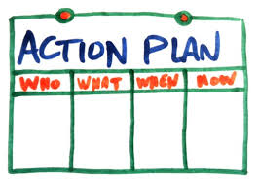
Sensemaking is a Conversation
Each team member brings their unique knowledge and experience of the event to the conversation
A facilitator uses a structured process to help team members combine these unique perspectives into a new shared mental model of what happened
Team members use this shared mental model to develop an action plan that decreases risks/hazards to individual patients and the system
(Battles et al., 2006)
This Photo by Unknown Author is licensed under CC BY-SA-NC
Notes:
Sensemaking occurs best during a conversation when
Each team member contributes their unique knowledge and experience of the event , a facilitator uses a structured process to help team members combine these unique perspectives into a new shared mental model of what happened, and then team members use this shared mental model to develop an action plan to decrease risks/hazards to individual patients and within the system as a whole.
The greater the complexity or ambiguity of an event, the more we need face-face sensemaking—a conversation—rather than individual interviews, emails to achieve this shared mental model. Sensemaking conversations enable team members to view their actions in the context of a system rather than as autonomous tasks.

Slide 122
Errors in Your Work Area
Think about your unit/department...
What types of errors occur most frequently? (Refer to previous slides).
Are individuals within units/depts making mistakes while performing well known tasks?
Are individuals within units/depts making judgement errors due to lack of rules/ policy/procedure?
Do groups/teams in different units/depts fail to coordinate well known information across multiple departments?
Do multiple departments and equipment fail to interact correctly in a complex system?
Discuss with your group and report out.

Slide 123
Obj. 3 Compare/Contrast Debrief & RCA
 | Debrief | Root Cause Analysis
What | Sensemaking Conversation: Retrospective, structured team meeting in which members make sense of and learn from a recent event (Scott et al., 2013) | Sensemaking Conversation: Retrospective, structured organizational investigation of sentinel events (Wald & Shojania, 2001)
Purpose | Unit/Dept System Improvement | Organization System Improvement
When | When a team’s plan does not go as anticipated (Unexpected negative OR positive outcome) When a team wants to learn from its experience and improve systems outcomes (Jones et al., 2019; AHRQ, TeamSTEPPS) | After all sentinel events death/permanent harm (or “near misses” that could have resulted in death/permanent harm) After all events that frequently result in incr. LOS or level of care Aggregate lower risk events (VHA National Center for Patient Safety)
How? | Structured process conducted by team/unit/dept leader who ensures psychological safety (Allen et al., 2018) | Structured process conducted by trained facilitator, knowledgeable of QI, who ensures psychological safety (VHA National Center for Patient Safety)

Slide 124
Objective 4
Recognize debriefs as a team leadership strategy that is integral to all other components of the teamwork system.
Notes:
Our first objective is to...

Slide 125
Team Meetings Manage Performance
Effective team leaders use three types of meetings to manage team performance within units/departments:
Brief: short, planned meeting to share the plan and organize the team
Clarify goals, roles, and responsibilities (delegate)
Anticipate needs, establish contingencies, manage resources
Know the plan, share the plan, review the risks
Huddle: ad hoc meeting to monitor and adjust the plan
Share information from individual situation monitoring
Provide opportunities to seek and offer task assistance
Debrief: planned or ad hoc meeting to review the plan and team performance after event
Review what happened and why it happened (regarding both task AND teamwork)
Decide what will be done differently for a patient and what can be applied to the system
Provide feedback and resolve conflict
(AHRQ, TeamSTEPPS)
Notes:
Read the slide.

Slide 126
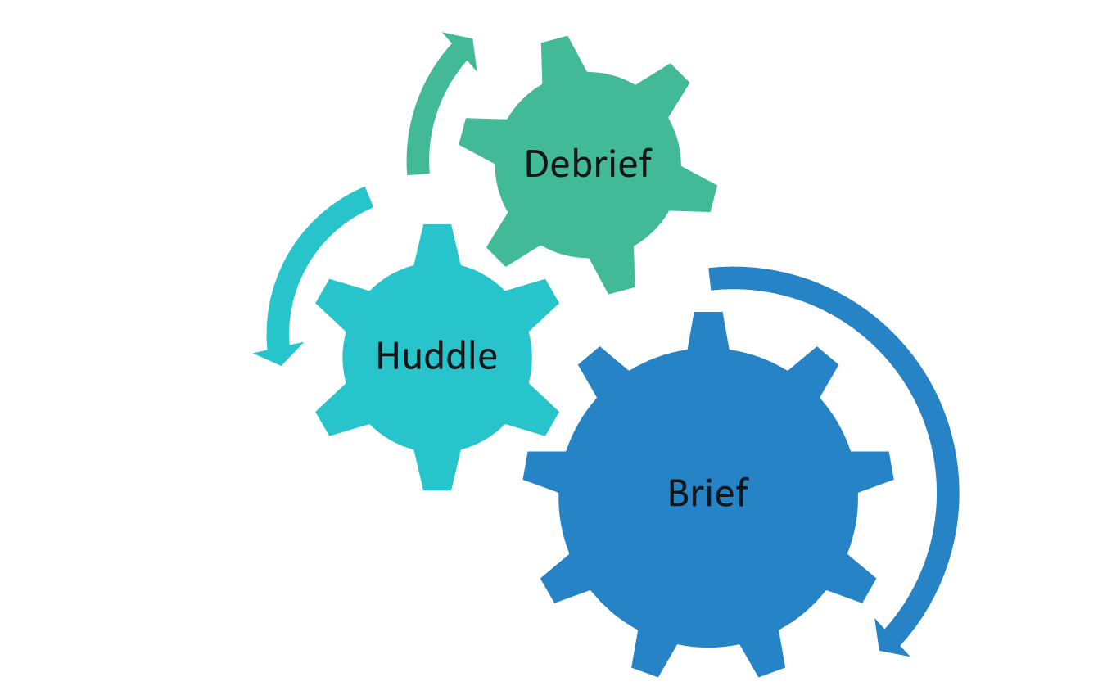
Leadership Tools to Manage Team Performance
Review the PLAN and team performance after event
What happened?
Why did it happen?
What will we do differently to prevent this event from reoccurring?
What can we apply to the system?
“Briefs, huddles, and debriefs need to be routine... help establish a culture of safety and ensure successful implementation of safety bundles.”
(Main et al., 2015. National Partnership for Maternal Safety:
Consensus Bundle on Obstetric Hemorrhage)
Adjust the PLAN due to changing circumstances or risks
Know the PLAN
Share the PLAN
Review the RISKS
Notes:
Sometimes pictures are better than words at describing the components of a system.
Briefs, huddles, and debriefs are team meetings to manage the PLAN, the shared mental model of what the team is doing!
>In the debrief, Know the PLAN, Share the PLAN, Review the RISKS
>In the huddle, we adjust the PLAN,
>In the debrief, we review the PLAN, did it go as planned, if not, why not, and what will we do differently both for the individual patient and the system as a whole.
As the National Partnership for Maternal Safety stated in their consensus bundle on obstetric hemorrhage, “Briefs, huddles, and debriefs need to be routine... help establish a culture of safety and ensure successful implementation of safety bundles.”
xxxxxx
These concepts are built into the hemorrhage bundle to remind members to communicate with the entire team. As briefings and huddles become more routine, members of response teams will have more awareness of their roles and they will be better able to use available resources. Teams will learn from each event, identify and correct systems issues, and continue to grow and improve. Furthermore, it is important for birthing facilities to support a culture in which all multidisciplinary team members are able to communicate their concerns and questions regarding care of obstetric
emergencies.51

Slide 127
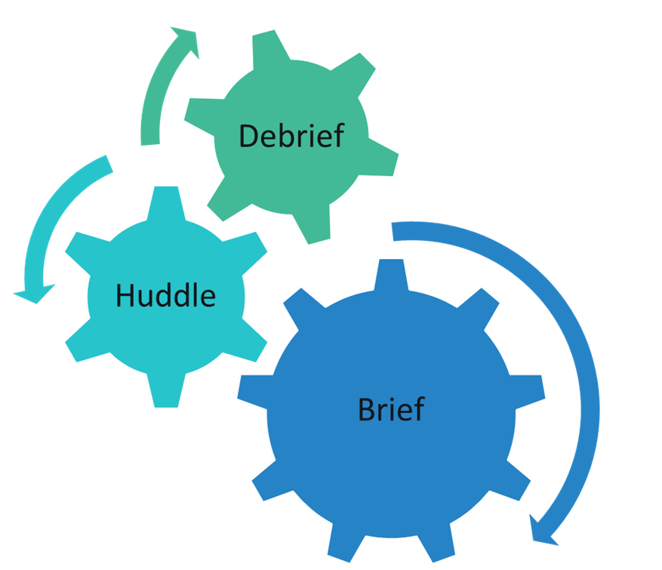
Debriefs Briefs, Huddles, Debriefs Initiate Teamwork
Closed-Loop Communication
Situation Monitoring
Shared Mental Model
Mutual Support (Seek/Offer Assistance)
System Performance
Safety Culture (Trust)
Team Performance
Adaptability
TRUST
(Adapted from Salas et al., 2005)
Notes:
We say that briefs, huddles, and debriefs initiate the teamwork system because during these meetings, team members can share what they know is going on around them and all team members develop a shared mental model of the situation, they can offer support to each other to better manage tasks and work load, which helps them to adapt to adapt and better manage complexity.
> It is this ability to adapt, that leads to improvement in system and team performance and improved trust which is at the core of a culture of safety.

Slide 128
Briefs Huddles Debriefs
Nursing Shift Change
Surgical Pre-procedure Check-In, Sign-In, Time-Out
Whole Hospital Morning Brief
Called as needed by designated or situational leaders to manage changing circumstances
Falls
Medication Errors
Surgical Sign-Out
Codes
Rapid Response
Obstetric Incidents
System Failures
(AHRQ, TeamSTEPPS)
Notes:
What you call the meeting is not as important as the facilitator of the meeting ensuring all team members have a shared mental model of the goal
Briefs are used to Plan and organize before an event such as nursing shift change, a surgical time-out, a whole hospital or department morning brief.....
A huddle is used to Adjust the plan due to changing circumstances and can be called by anyone who perceives the need
And a debrief is used to Review team performance after the plan is executed and an unexpected event has occurred.

Slide 129
Briefs Huddles Debriefs
Non-Clinical Examples
Non-Clinical Examples
Non-Clinical Examples
(AHRQ, TeamSTEPPS)
Notes:
What you call the meeting is not as important as the facilitator of the meeting ensuring all team members have a shared mental model of the goal
Briefs are used to Plan and organize before an event such as nursing shift change, a surgical time-out, a whole hospital or department morning brief.....
A huddle is used to Adjust the plan due to changing circumstances and can be called by anyone who perceives the need
And a debrief is used to Review team performance after the plan is executed and an unexpected event has occurred.

Slide 130
Objective 5
Explain the structure and organizational context of effective debriefs in which the goal is to improve system outcomes.
Notes:
So, now you understand that debriefs as team meetings, sensemaking conversations, that are facilitated by a leader to review the plan after an event. Now, let’s find out what we know about how to conduct effective debriefs and how an organization can support effective debriefs.

Slide 131
Characteristics of Effective Debriefs
(Allen et al., 2018; Tannenbaum & Cerasoli, 2013; Smith-Jentsch et al., 2008; Smith-Jentsch et al., 1998)
Short
Structured
Trained Facilitator
Improved System Outcomes
Structure is Needed to...
Ensure focus on specific situation AND on how decisions were made (right decision and right decision-making process)
Avoid conflict
Summarize both positive (what went well) and negative feedback (what did not go well)
Notes:
Effective debriefs are short, structured, and conducted by a trained facilitator to achieve the goal of improved system outcomes.
Short means 3 – 5 minutes, and no longer than 10 minutes.
Structure is needed to...
Ensure focus on the specific event AND on how decisions were made...that is, we need structure to be sure we make sense of both the tasks done during the event and our thinking during our decision-making and teamwork.
Structure is needed to Avoid conflict, and finally,
Structure is needed so that we remember to Summarize what went well and what did not go well.
Think of a structured debrief as a mental guide that a trained facilitator completes. The guide is a tool to structure the sensemaking conversation that results in learning and systems improvement.
xxxxx
Research with its origins in the military found that without structure, see Smith-Jentsch (2008)

Slide 132
Characteristics of Effective Debriefs
(Allen et al., 2019; Tannenbaum & Cerasoli, 2013; Smith-Jentsch et al., 2008)
Available at: https://www.nepatientsafety.org/resources-tools/
Short
Structured
Trained Facilitator
Improved System Outcomes
Generic Structure
Create a safe environment
Begin with those with least status
What happened?
Why did it happen?
What will we do differently to prevent recurrence of this event? (consider task and teamwork)
What can we apply to the system?
Event Specific Structure
Peri-natal Events (e.g. OB Hemorrhage)
Post-fall Huddle
Surgery – (Integral to Comprehensive Surgical Checklist)
Notes:
We can think of debriefs as having a generic or an event specific structure.
You can use the generic structure for any event, but it is especially appropriate for system disruptions and non-clinical areas. Use the generic structure to debrief after an EMR shut-down or an operational change due to construction or staffing. Leaders in administrative and support areas such as env services and dietary can use the generic structure.
There are also event specific debriefs for peri-natal events, falls, and the sign-out period during a surgical procedure.
Facilitators need to be trained to keep the focus of the meeting on the sensemaking conversation. You will not achieve your goal of system improvement through learning if the focus during the debrief is checking boxes on a form.
Examples will be posted in our electronic toolkit on the NCPS web site.

Slide 133
Context of Effective Debriefs
(Allen et al., 2019)
Short
Structured
Trained Facilitator
Improved System Outcomes
Psychological Safety
Organizational Support
“A climate in which people feel free to express relevant thoughts and feelings.” (Edmondson, 2012)
Restructure the organization and clarify roles to provide people, training, time to implement changes; overtly value the change (Rogers, 2003; Allen et al., 2018)
Sensemaking
Team Reflexivity
“...the active process of assigning meaning to ambiguous data.” (Edmondson, 2012)
Extent to which team members reflect upon the team’s goals, decision-making strategies, and processes (West, 2000)
Notes:
A trained facilitator will use a generic or event specific structure to debrief AND they will keep in mind the environment or context of the debrief they want to create.
The biggest determinant of the success of a debrief is that each team member feels psychologically safe to speak up and share what they know about the event.
>The facilitator creates this atmosphere of safety by keeping the focus on sensemaking about the event and
> By encouraging the team to reflect about how they worked together...
> However, the most important aspect of the environment of the debrief is support at the organizational level, which the facilitator cannot control. The main reason we aren’t using debriefs more frequently is lack of organizational support. The nature and role of organizational support for debriefs will be the focus of our 2nd webinar.

Slide 134
Debrief Pocket Guide: Template for Structure
Available at: https://www.nepatientsafety.org/resources-tools/patient-safety-improvement-tools/debrief-toolkit.html
By definition, if an
error/event was preventable, there was an error. The fix for an error depends upon its origin.
Notes:
A pocket guide for a generic debrief is available in the debrief toolkit on the NCPS website. Debrief facilitators can use this guide to structure their debriefs to achieve psychological safety, sensemaking, team reflexivity, and ultimately system improvement.
Let’s put structure and context together by using the pocket guide, which Dr. Nailon sent you yesterday via email.
At the beginning of the debrief, start by reviewing the objectives.
> Create psychological safety by establishing the ground rules, listening, seeking the facts, calling on the team member with least status first, avoiding judgment, asking why to facilitate sensemaking, summarizing what was learned and thanking all team members for their participation.
> Now, the facilitator is ready to start the debrief: Here is a short scenario...
Facilitator says: “We want to better understand what happened when we were short two CNAs today, why it happened, and how we can improve.”
Facilitator asks a CNA: “Jennie, what happened from your perspective?” Jennie says: “I didn’t get vitals done because I was over-whelmed answering call lights.”
Facilitator asks, John, a nurse: “What was different this time?” John says: “I was busy admitting two patients and didn’t notice Jennie was overwhelmed.”
Facilitators asks the team: “Why didn’t we notice Jennie was overwhelmed? How could we have prevented this?” Susie, a nurse, says: “We were all just focused on getting our own work done.”
Facilitator asks: “Do we need to change what we do when we are short-staffed? Jennie says: “The CNAs need to be able to ask for help.” Another nurse says: “Yes, we can take our own patients’ vital signs when we are short CNAs.”
Facilitators asks: “How can we be sure that an overwhelmed team member gets help?” John says, “anyone who is overwhelmed should feel free to call a quick huddle.”
Facilitator summarizes: “going forward, when we are short CNAs, nurses will take their own vitals signs so the remaining CNAs can focus on call lights. And I will call a mid-morning and mid-afternoon huddle to check on work-loads so team members can ask for help. But, remember, anyone can call a huddle if you are over-whelmed and patient safety is at stake. Thank you for your participation and your honest answers. I’ll share what we learned here with other charge nurses and the QI team that coordinates debriefs. Finally, the facilitator completes the debrief log for her unit. This log is a very short form that identifies this event as a coordination error and that the lessons learned were the need to clarify nurse roles and call more frequent huddles when a unit is short staffed.
>Note that the facilitator should be able to recognize whether errors made were at the individual level and/or the organizational level such, which include coordination and system errors. If you correctly diagnose the problem—the type of error—it is easier to plant the fix. We’ll discuss these error types shortly.

Slide 135
Team Meetings Improve Team Performance by Improving Resilience
Leadership
Resilience—ability to manage complexity, adapt to changing conditions
Resilience requires ability to plan and anticipate (brief), monitor and respond (huddle), and learn from experience (debrief)
Review of 36 studies found the following support resilience:
Frequently exchanging information between experts and novices
Combining perspectives of different team members
Using protocols and checklists
Creating a shared mental model of work as imagined (the policy/procedure) vs work as actually done
Conclusion: Implementing briefs, huddles, and debriefs are key strategies to improve organizational resilience in response to internal and external challenges. (Iflaifel et al, 2020; Hollnagel et al., 2006)
Notes:
First, there is evidence that debriefs improve organizational resilience.... A systematic review of 36 studies sought to understand factors associated with resilient health care. Resilience refers to a system’s ability to manage complexity and changing conditions; especially in complex systems that include people and technology. Resilience requires the ability to anticipate (like planning during a brief), monitor and respond to changes (like adjusting during a huddle), and learn (ike reviewing performance during a debrief). The following factors contributed to resilience:
> Read the factors using the laser pointer.
The authors concluded that Implementing briefs, huddles, and debriefs are key strategies to improve organizational resilience in response to internal and external challenges.

Slide 136
Track Debrief Outcomes
Use/Adapt Debrief Log (for facilitators) and Database Templates (for Debrief Coordinating Team) in Toolkit
Share results of lessons within/across departments
Date | Facilitator Initials | Event | Error Type* | Actions Taken | Lessons Learned
*Task = While performing a well understood task, an individual inadvertently did the wrong thing (slip) or forgot a step (lapse) Judgment = While performing an uncertain process, an individual made a decision with too little/wrong information (mistake) Coordination = While performing a known process, multiple people failed to share information and coordinate goals, roles and accountability across shifts, work areas, levels/settings of care System = Multiple system elements (people, technology) interact resulting in failure to achieve intended goals

Slide 137
NCPS Debrief Toolkit
Debrief Fact Sheet to Educate Management and Leaders
Debrief Policy/Procedure
Debrief Coordinating Team Charter
Debrief Log for Facilitators
Debrief Database for Coordinating Team
Generic Debrief Pocket Guide
List of Online Videos for Training
OB Hemorrhage
Council On Patient Safety In Women’s Health Care Patient Safety Bundles
Post-Fall Huddle
AORN Comprehensive Surgical Checklist
Available at: https://www.nepatientsafety.org/resources-tools/patient-safety-improvement-tools/debrief-toolkit.html
Notes:
Finally, these are the tools we plan to include in the toolkit. If there is something else you would like to see, let us know.
The toolkit will be up by June 9.

Slide 138
Improvement Solutions?
How likely is it that regularly conducting briefs, huddles, and debriefs will improve your staff’s perceptions that...
You seriously consider staff suggestions for improving patient safety.
You take action to address patient safety concerns that are brought to your attention.
Your unit/department regularly reviews work processes to determine if changes are needed to improve patient safety.
In your unit, changes to improve patient safety are evaluated to see how well they worked.
In your unit, the same patient safety problems DO NOT keep happening.

Slide 139
Improvement Solutions?
How likely is it that regularly conducting briefs, huddles, and debriefs will improve your ability to lead within each of the Clifton Strengths Domains?

Slide 140
Objective 6
Describe the steps and attributes of a thorough, credible, acceptable root cause analysis and action plan.

Slide 141
When to Conduct RCA2
After a Sentinel Event, which reaches a patient and results in any of the following:
Death
Permanent harm
Severe temporary harm
Or on the enumerated list of events Reportable to The Joint Commission (Joint Commission Sentinel Event Policy)
OR risk thereof…includes any process variation for which a recurrence would carry a significant chance of serious adverse outcome. Sentinel Event signals need for immediate investigation and response to identify systems problems and continuing threats to patient safety. (VHA National Center for Patient Safety)
For coordination and system errors in which processes cross department/unit boundaries
Notes:
Actual SEs are reportable to TJC per their policy…
What is reportable to state?

Slide 142
Steps in Root Cause Analysis & Action
Trained facilitator gathers facts to develop a timeline by conducting brief interviews, gathering supporting materials (e.g., medical Record, policies/procedures), visiting the site
Interdisciplinary Team (ID Team) led by facilitator seeks to understand what happened using the timeline, repeatedly asking why, and compares events to what should have happened (visits site, views pictures of site)
ID Team identifies root causes of events in timeline using causal map, fishbone diagram, and causal statements for double-check
ID Team determines system improvements (of varying strengths) to minimize risk of repeating the event
Trained facilitator collaborates with relevant departments to finalize who, what, when and outcome measures in action plan. (ID Team reviews/approves plan).
(Amo, 1998; Nicolini et al., 2011; National Patient Safety Foundation, 2016)
Notes:
what happened, why did it happen, and what can be done to prevent it from happening again?

Slide 143
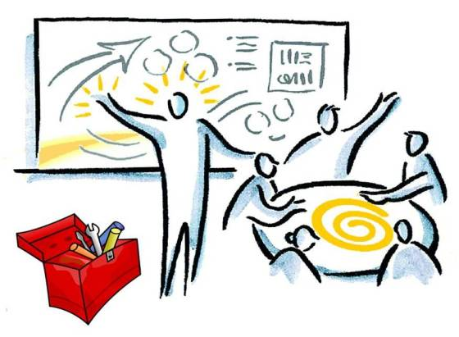
Qualifications of RCA Facilitator
Criteria (National Patient Safety Foundation, 2016)
NOT directly involved in event
No preconceived idea of causal factors
Knowledgeable of RCA purpose and process
Credibility within organization
Skills in patient safety, human factors, quality improvement, and implementation
Facilitation Skills (Nicolini et al., 2011)
Sets agenda, manages time, stays on task
Manages hierarchical and dominating behaviors
Non-verbal hand on shoulder
Verbal: request break
Acknowledges and validates emotions
Avoids focus on “when” at expense of “why”
Doesn’t value “done report” over learning and action planning
Notes:
You do not want someone facilitating the conversation that comes to the table with the idea of “we already know what happened and I already have started fixing the problem”
- Ideally the facilitator is not an administrator or director. A peer is great. QI director is great. Someone who is process oriented and able to keep self and others on task. They must have the ability to look at the whole process and not be narrowly focused on one or two issues.

Slide 144
Credible, Thorough, Acceptable RCA
Credible (clear, complete, systematic, considers diverse perspectives)
Based on a detailed timeline of the events originating from the medical record and initial interviews with those involved in the event (including patient/family as appropriate)
Conducted by interdisciplinary team led by trained facilitator
ID Team led by trained facilitator investigates key events in the timeline by asking why multiple times
Thorough (considers all possible systemic factors)
Includes a causal map and causal statements
Considers traditional RCA causal categories
Acceptable
Action plan specifies interventions that will reduce risk of recurrence and includes stronger or intermediate actions
Action plan specifies process and outcome measures
(Joint Commission Sentinel Event Policy; VHA National Center for Patient Safety; Wu, et al., 2007)

Slide 145
WHY
ADC only required 2 letters, defaulted to generic
Timeline
Nurse from unit chose drug based on VE
Radiology did not want to give medication
Over-rides were common, expected due to recent EHR-ADC update
Nurse over-rode alert
Outcome
Multitasking (precepting)
Nurse did not look at vial
Patient dies after receiving the wrong medication (a paralytic) in radiology
BCMA not available in radiology
Nurse administered medication without verifying 7 rights
Behavioral drift
Nurse needed back on the floor, was precepting
Nurse did not monitor pt. after administering drug
Thought drug was Versed
Radiology did not notice change in pt. status for 25 minutes
Relies on camera surveillance

Slide 146
Patient/Resident Factors
Age:
Primary Dx:
Comorbidities:
Relevant Lab Values:
Other:
Environmental Factors
3. Why, why, why?
2. Identify causes in Timeline*
1. Undesired outcome
Day ___ Time ___
Day ___ Time ___
Day ___ Time ___
Day ___ Time ___
Day ___ Time ___
*Events/causes in the timeline may be human errors or behavioral choices; each human error or behavioral choice should have a preceding cause that answers the question “why?”

Slide 147
Five Rules for Causal Statements
Clearly show cause and effect relationship
Use specific and accurate descriptions
Identify the system cause of the error
Identify preceding cause of policy or procedure violation
Acknowledge: failure to act is only causal when there is a preceding duty to act based on known policy/procedure
Notes:
AT

Slide 148
Fill in the blanks…
The lack of______________________ resulted in______________________, which increased the likelihood that____________________________.
If it doesn’t fit…use the parking lot.
Notes:
AT

Slide 149
Fill in the blanks…
The lack of timely review of medication orders by pharmacy resulted in RaDonda over-riding the alert, which increased the likelihood that the patient would receive a paralytic by mistake and die.
If it doesn’t fit…use the parking lot.
Notes:
AT

Slide 150
Fill in the blanks…
The lack of dry shoes, grab bars, carpeted floor, resulted in ______________________________, which increased the likelihood that she would trip over her cane and fall sustaining rib fractures.
If it doesn’t fit…use the parking lot.
Notes:
AT

Slide 151
Fill in the blanks…
The lack of a policy to not leave patients at high risk for falls unattended in the pool locker room, resulted in the patient being left unattended to change in the pool locker room, which increased the likelihood that she would trip over her cane and fall sustaining rib fractures.
If it doesn’t fit…use the parking lot.
Notes:
AT

Slide 152
Communication & Team Factors
Culture/ Organizational Factors
Environment/ Equipment
Human Factors
Information Management
Describe Patient Outcome
Rules/Policies/ Procedures
Safeguards (Barriers & Controls)
Staffing Factors
Task Factors & Training

Slide 153
Summary
Learning
Reporting
(Formal & Informal)
Just
(Shared Accountability/Trust)
Flexible (Teamwork)
Safe
Informed
Just – reporting is rewarded in an atmosphere of trust; clear line between acceptable & unacceptable behavior; shared accountability between management and staff to address root causes of events
Reporting – staff report their errors
Flexible (Teamwork)– authority gradients relax when safety information is exchanged; there is psychological safety to speak up about safety related information
Learning – action is taken based on safety information systems and sensemaking conversations
Four Key Components of a Culture of Safety
Reason, J. Managing the Risks of Organizational Accidents. Hampshire, England: Ashgate Publishing Limited; 1997.
153
Notes:
153
Based upon James Reason’s work, there are four key components of a culture of safety. First, reporting practices must be supported by an atmosphere of trust and a culture that seeks to establish a shared accountability between management and individual employees. Management is accountable for the role system design may play in adverse events, and individuals are accountable for the role behavioral choices may play. Reporting and just cultures support behaviors that establish a flexible/teamwork culture--open communication, situation monitoring, seeking and offering task assistance, and advocating for patients. Reporting, just, and flexible cultures support the use of tools such as root cause analysis and process mapping that enable organizations to learn from their experience. As Reason indicates, it is the deliberate engineering of interactions between the practices of reporting, just, flexible, and learning cultures that results in a safe, informed culture.
Reporting
“Any safety information system depends crucially on the willing participation of the workforce, the people in direct contact with the hazards. To achieve this, it is necessary to implement a reporting culture—an organization in which people are prepared to report their errors and near-misses.”
Just
“What is needed is a just culture, an atmosphere of trust in which people are encouraged, even rewarded, for providing essential safety-related information—but in which they are also clear about where the line must be drawn between acceptable and unacceptable behavior.”
Flexible
“A flexible culture takes a number of forms, but in many cases it involves shifting from the conventional hierarchical mode to a flatter professional structure, where control passes to task experts on the spot, and then reverts back to the traditional bureaucratic mode once the emergency has passed.”
Learning
“An organization must possess a learning culture—the willingness and the competence to draw the right conclusions from its safety information system, and the will to implement major reforms when their need is indicated. . . In most important respects, an informed culture is a safety culture.”

Slide 154
Five Skills Support Just Culture
1. ALIGN VALUES & EXPECTATIONS
2. DESIGN BETTER SYSTEMS
3. MAKE BETTER BEHAVIORAL CHOICES
4. LEARN TO SYSTEMATICALLY LEARN
Severity of Outcome
Due to Error
5. FIND JUSTICE
Notes:
Outcomes (positive or negative) are determined by the interaction between system design, risk we are willing to tolerate, and behavioral choices.
When an error happens, what is your current focus...the severity of the outcome or the system that produced the error
This is the model you will learn to change your culture from a focus on errors as outcomes, to a focus on the structures and processes such as system design, risk, and behavioral choices that produce those outcomes A key principle is to change the organization’s focus from errors as outcomes, to an analysis of how system design, risk, and behavioral choices produces those outcomes.
Risk = likelihood of an event x severity of the event.
>There are 5 specific skills needed to support a just culture and achieve better outcomes. Reflecting the principle of shared accountability... Managers are primarily accountable for skills .... 1,2,4,5 and employees are accountable for 3.

Slide 155
Leadership Tools to Manage Team Performance
Review the PLAN and team performance after event
What happened?
Why did it happen?
What will we do differently to prevent this event from reoccurring?
What can we apply to the system?
“Briefs, huddles, and debriefs need to be routine... help establish a culture of safety and ensure successful implementation of safety bundles.”
(Main et al., 2015. National Partnership for Maternal Safety:
Consensus Bundle on Obstetric Hemorrhage)
Adjust the PLAN due to changing circumstances or risks
Know the PLAN
Share the PLAN
Review the RISKS
Notes:
Sometimes pictures are better than words at describing the components of a system.
Briefs, huddles, and debriefs are team meetings to manage the PLAN, the shared mental model of what the team is doing!
>In the debrief, Know the PLAN, Share the PLAN, Review the RISKS
>In the huddle, we adjust the PLAN,
>In the debrief, we review the PLAN, did it go as planned, if not, why not, and what will we do differently both for the individual patient and the system as a whole.
As the National Partnership for Maternal Safety stated in their consensus bundle on obstetric hemorrhage, “Briefs, huddles, and debriefs need to be routine... help establish a culture of safety and ensure successful implementation of safety bundles.”
xxxxxx
These concepts are built into the hemorrhage bundle to remind members to communicate with the entire team. As briefings and huddles become more routine, members of response teams will have more awareness of their roles and they will be better able to use available resources. Teams will learn from each event, identify and correct systems issues, and continue to grow and improve. Furthermore, it is important for birthing facilities to support a culture in which all multidisciplinary team members are able to communicate their concerns and questions regarding care of obstetric
emergencies.51

Slide 156
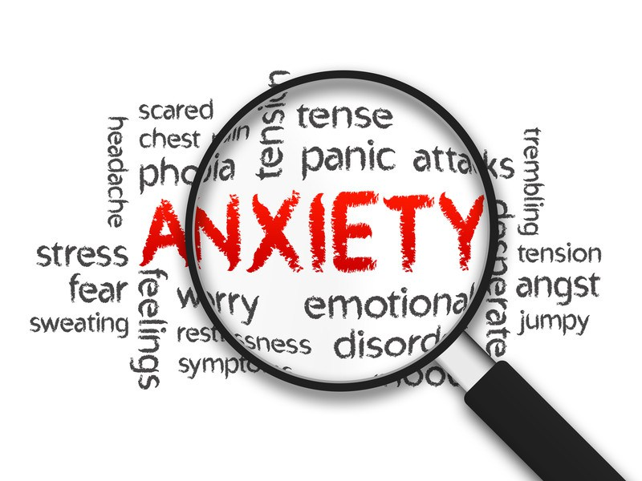
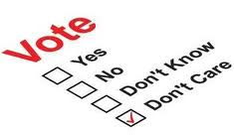
Learning: Intersection between psychological safety & accountability
Psychological Safety | High | Comfort Zone | Learning Zone
 |  | Apathy Zone | Anxiety Zone
 | Low | Low | High
 |  | Accountability
“A climate in which people feel free to express relevant thoughts and feelings.”
This Photo by Unknown Author is licensed under CC BY-SA-NC
This Photo by Unknown Author is licensed under CC BY
This Photo by Unknown Author is licensed under CC BY
This Photo by Unknown Author is licensed under CC BY-NC-ND
(Edmondson, 2012)

Slide 157
Objective 7
Identify Next Steps needed to implement Just Culture and Debriefs as leadership strategies in your organization.

Slide 158
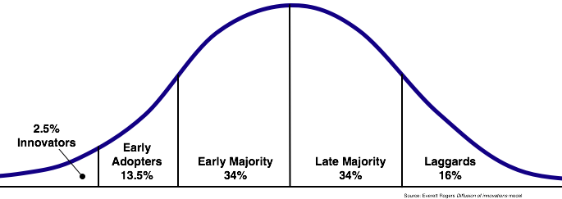
Innovation: Participative Leaders Use Just Culture Principles & Tools, Conduct Debriefs
Getting a new idea adopted, even when it has obvious advantages, is difficult. Many innovations require a lengthy period of many years from the time when they become available to the time when they are widely adopted.
Rogers EM. Diffusion of Innovations (5th ed.). New York, NY: Simon & Schuster; 2003. pp. 1, 281.
Notes:
Rogers’ bell-shaped curve graphically represents the variability in organizational and individual adoption of innovation. This curve is consistent with what we know it often requires years for an innovation to be widely adopted.

Slide 159
Attributes of Easily adopted Innovations
Relative advantage—Are Just Culture and Debriefs a clear advantage over the “old way?”
Compatibility—Are Just Culture and Debriefs compatible with your existing mission and values?
Complexity—Are the concepts behind Just Culture and Debriefs simple to understand?
Trialability—Can leaders try out Just Culture principles/tools and Debriefs and learn by practicing and receiving feedback from peers?”
Observability—Will leaders see that others who use Just Culture and Debriefs receive positive feedback?
Rogers EM. Diffusion of Innovations (5th ed.). New York, NY: Simon & Schuster; 2003.
Notes:
As Everett Rogers, author of Diffusion of Innovations, indicated, the potential adopter of an innovation must believe that the innovation:
Provides a relative advantage…it is better than the old way of doing thing
Is compatible with existing mission and values of the organization
Is not overly complex
Is trialable…staff can try out the innovation on a limited basis and learn by doing
Is observable…staff observe others engaged in the change and the feedback they receive is positive
The components of the Just Culture program are consistent with these attributes: three ways to deliver the curriculum and an emphasis on coaching and action planning in the context of improving safety culture.

Slide 160
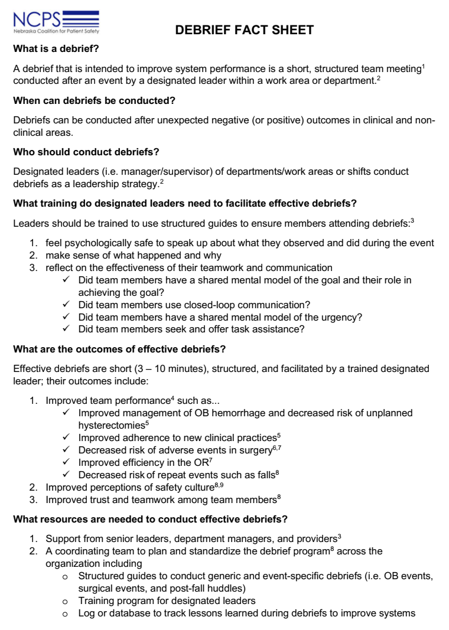
Debrief Fact Sheet
Provide awareness and knowledge of debriefs to persuade individuals to “buy-in” to conducting debriefs
Isn’t learning in real time better than repeating similar errors?
Available at: https://www.nepatientsafety.org/resources-tools/patient-safety-improvement-tools/debrief-toolkit.html

Slide 161
Putting it all Together: Where are the barriers?
Restructure Organization
Policies/Procedures
Additional Training Needs
Just Culture Algorithms
Structured Debrief Guides
Database for Debrief Outcomes
Clarify Roles and Routinize
Job Descriptions
Performance Appraisals
Trained Leaders
Use Just Culture Algorithms
Conduct debriefs
Ensure Psychological Safety
Achieve Sensemaking within and across departments
(Adapted from Helfrich et al., 2007)
Notes:
This framework reveals the essential role of management support for implementing complex innovations. Our survey results revealed that there lack of buy-in from Clinical and non-clinical leaders is a barrier to implementing debriefs in NE hospitals.
> So, at the organizational level we need to identify the need that debriefs will meet and at the individual level, we need to educate leaders about how and why debriefs work, and the evidence that exists that reveals their effectiveness.
With management support, you will have the resources/structures you need to implement effective debriefs.
When debriefs are effective you confirm to individuals that they were right to support these efforts and achieve the goal of system improvement

Slide 162
Barriers?
Think about your unit/department...
What barriers exist to implementing just culture and debriefs
Do policies/procedures explain your duty to use these tools?
Do you have the knowledge and skills needed to use these tools? What additional training/practice is needed?
What supporting materials do you need? (Debrief Pocket Guide/Fact Sheet, Debrief Log? Just Culture Algorithms?)
Do you receive positive feedback when you use the tools?
Is use of the tools part of your job description and performance appraisal?
Discuss with your group and report out.
Notes:
Each unit/department leader has to decide to implement the Just Culture principles and tools and Debriefs; then receive confirmation for their choice
The organization must decide whether use of the Just Culture principles and tools and Debriefs is how you will improve organizational learning and resilience.
If these decisions are made, then the organization must:
Restructure the organization to support the implementation …
Clarify roles and responsibilities associated with the implementation…
Routinize Just Culture and Debriefs principles and tools by changing policy/procedure, job descriptions, performance appraisals

Slide 163
Next Steps: WHAT, who, When
WHAT | WHO | WHEN

Slide 164
Nebraska Coalition for Patient Safety
Thank you!
Emily Barr, OTD, MBA, OTR/L, BCG
Executive Director
embarr@unmc.edu
Carla Snyder, MHA, MT(ASCP) SBB, CPHQ
Patient Safety Program Director
carlasnyder@unmc.edu
Katherine Jones, PT, PhD
Director, Surveys on Patient Safety Culture
katherine.jones@unmc.edu

